Slide 1


Understanding taxes
Guide to financial success
Helen frays-jones
Meriwest Credit Union

Slide 2
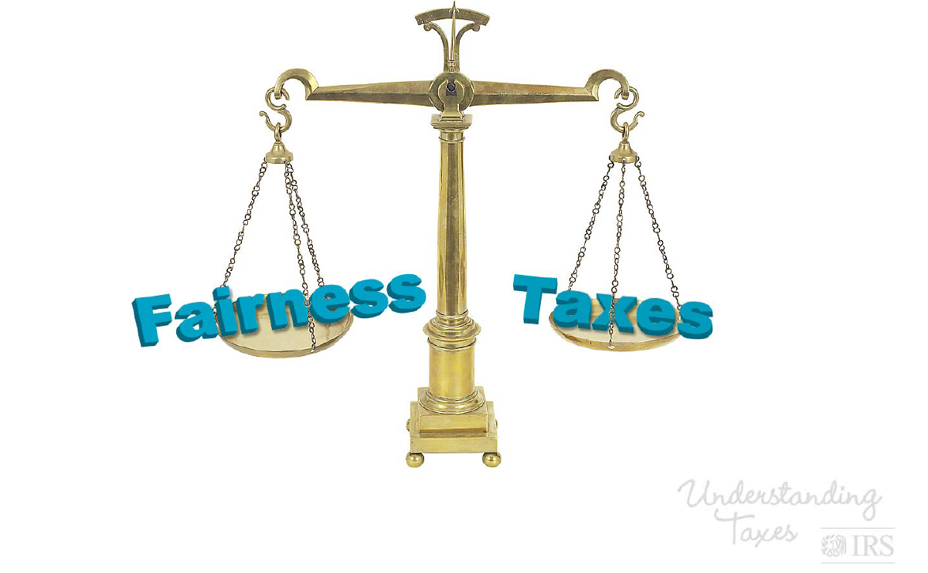
Fairness and taxation

Slide 3
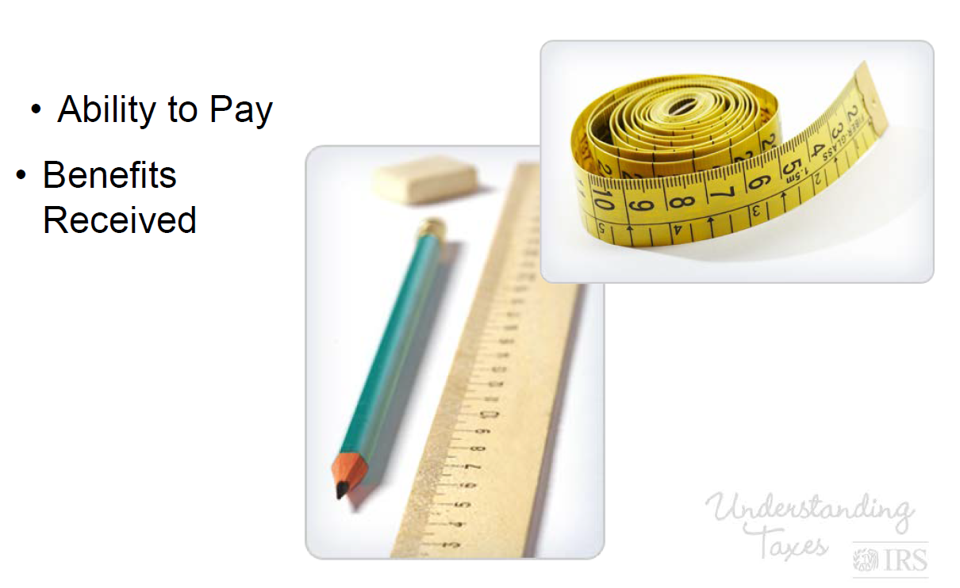

How to measure tax fairness
Ability to pay
Benefits Received

Slide 4
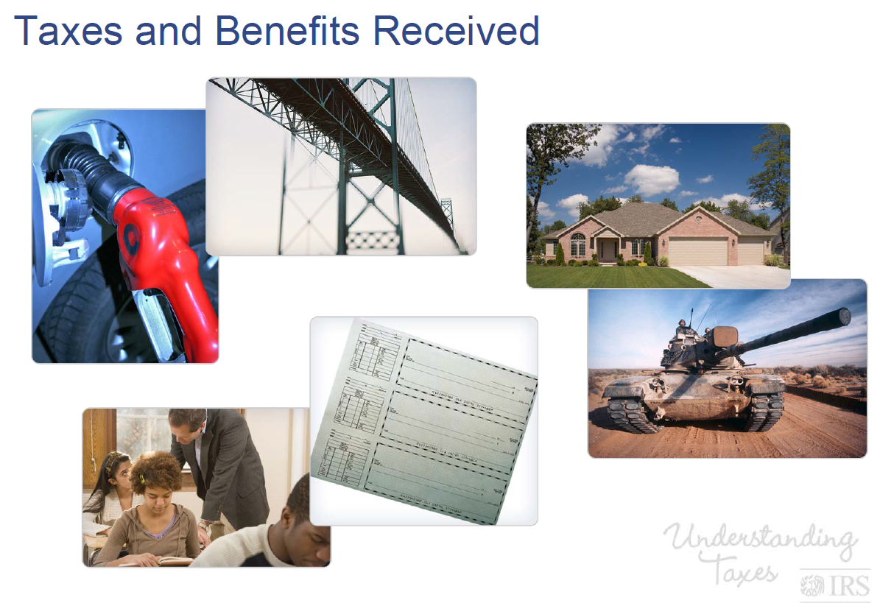

Taxes and benefits received

Slide 5
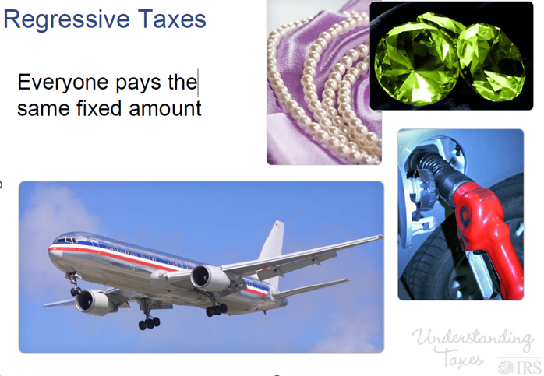
regressive taxes

Slide 6
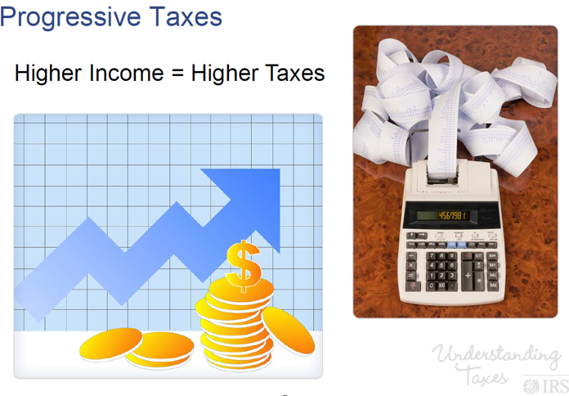
Progressive taxes

Slide 7
Income tax
When should you file?
  File Form 1040 by April 15th, 2026

Slide 8
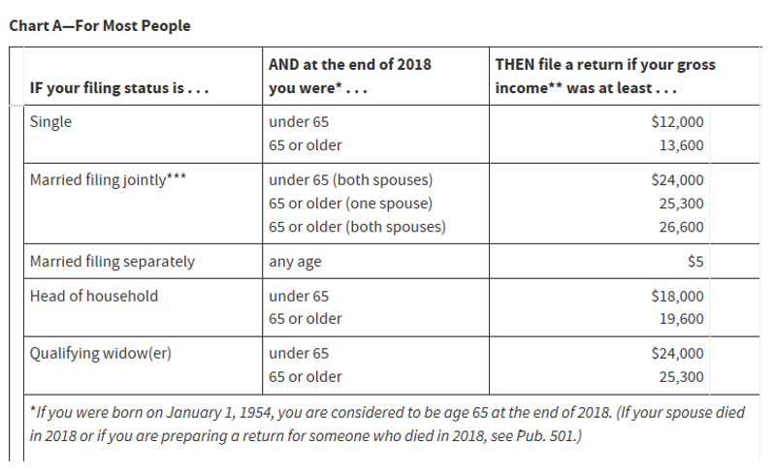
Who should file for tax

Slide 9
Form 1040 redesign
Effective 2019 the redesigned Form 1040 should be used.
  It has 6 new numbered schedules.
Most people will only need to file Form 1040 and none of the new numbered schedules.
  If your return is more complicated, where you claim certain deductions or credits, or owe additional taxes, you will need to complete one of more of the numbered schedules.
If you e-file your return, you generally will not notice much of a change and the software you use will determine which schedule you need.

Slide 10
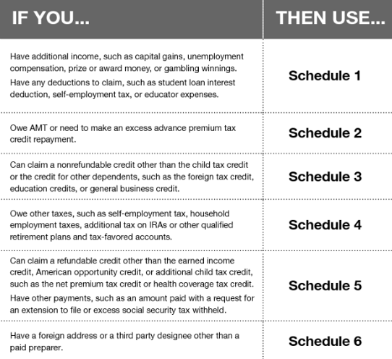
General guide to schedule

Slide 11
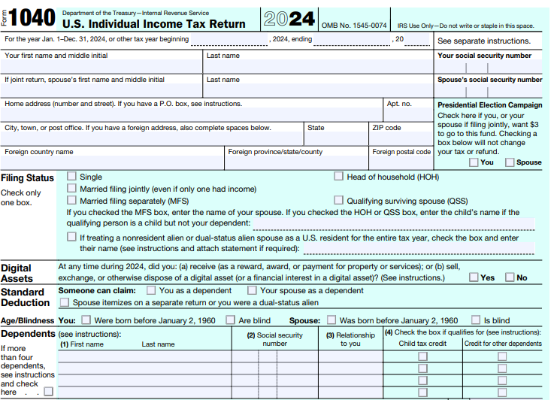
Form 1040

Slide 12
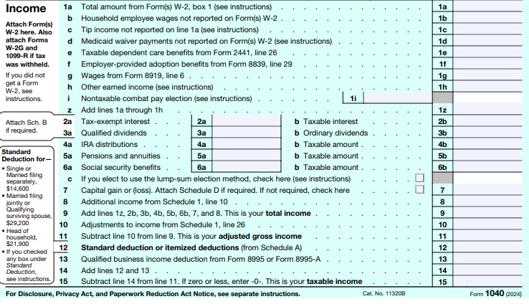
Form 1040 continued - income

Slide 13
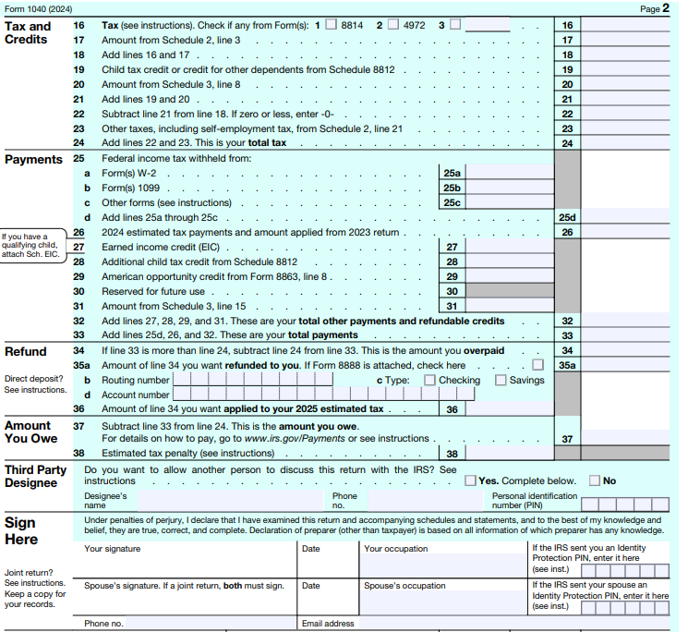
Form 1040 – Page 2

Slide 14
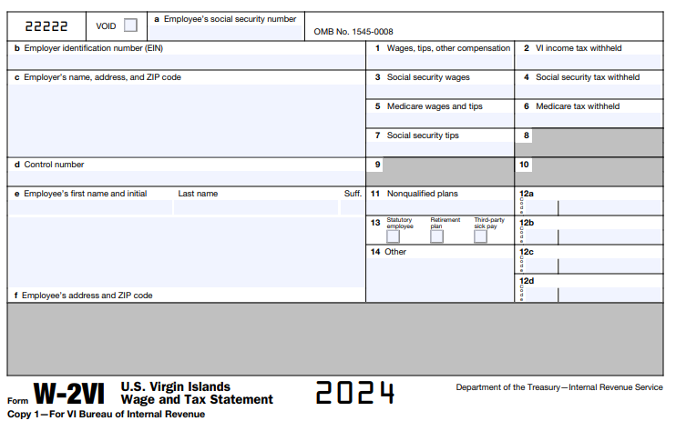
Sample copy of w2

Slide 15
Why Meriwest credit union?
-Member-Owned and Operated:
  We are owned and controlled by our members, not share holders, which means decisions are made in the best interest of the members.
Lower Fees:
  We typically offer lower fees for services such as checking accounts, loans and overdrafts compared to banks.
Better Interest Rates:
  Members often enjoy higher interest rates on savings accounts and lower interest rates on loans making us a more cost-effective choice. Our Premier Saving account pays as high as 5.0% APY. The best rate in the industry.
Personalized member Service:
  Profits made by Meriwest Credit Union are returned to the members in the form of reduced fees, higher savings rates, and improved services, rather than paid out in dividends to share holders.
Community Focus:
  We are committed to serving the local communities, often investing in local projects and providing financial literacy and support.

Slide 16
Thank You

