Slide 1

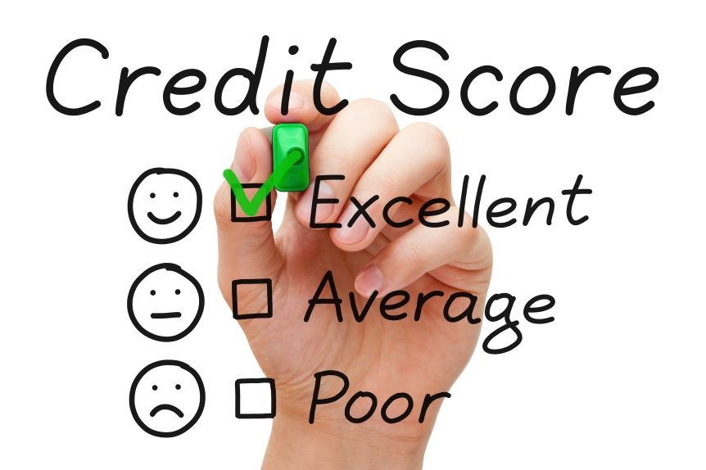

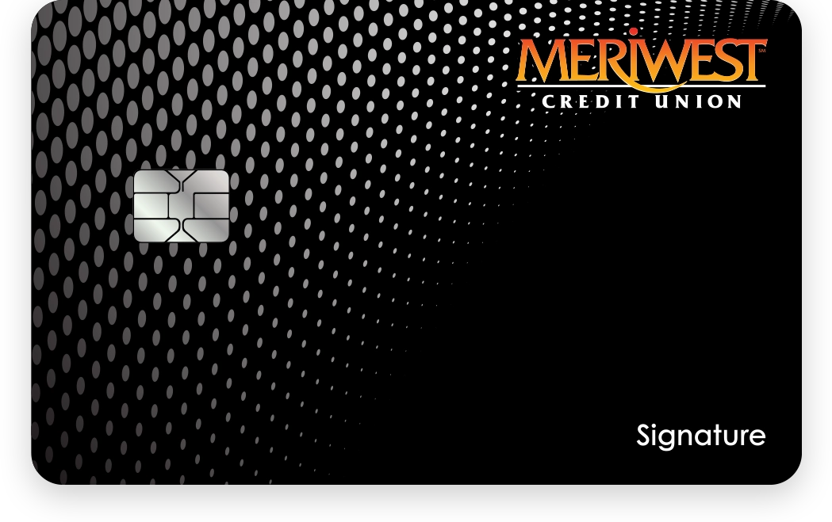
ABC’s of credit & Improving your credit score
It’s not your money.
You’re borrowing it.

Slide 2

Agenda
What is a FICO Score?
Myths of Credit
Types of Credit
Tips for Improving your Credit Score
Disputing Items on your Credit Report

Slide 3

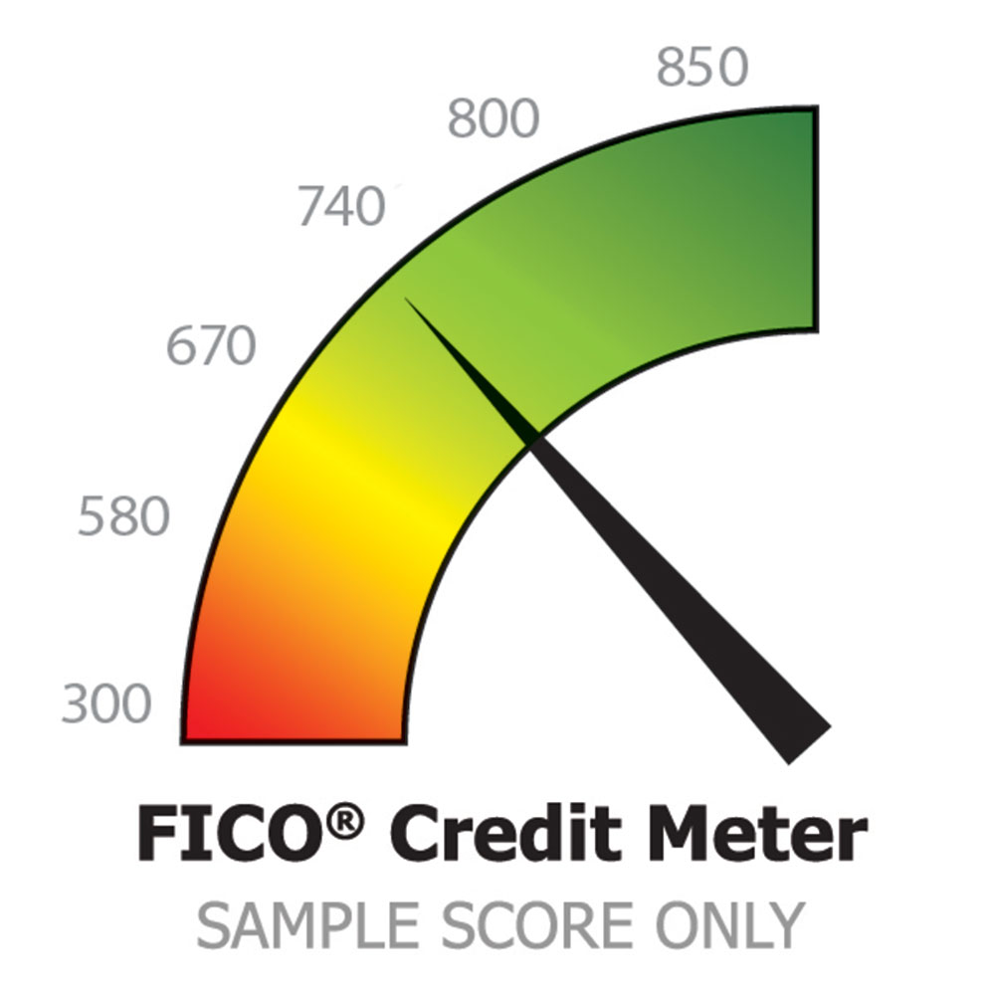
Types of Credit/Financing/Score/Revolving Credit & Installment Credit
What is a FICO Score?

Slide 4
Fico score
Stands for Fair Isaac Corporation
The largest and best known of several companies that provide software for calculating a person’s credit score
This is a standard credit score
Typically used by most financial institutions & dealerships

Slide 5
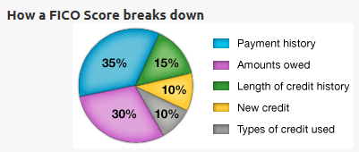
What are the components of your FICO Score?

Slide 6
Payment History = 35%
Refers to the monthly payment history
If you are having trouble making ends meet – Contact your creditors
Includes public record and collection items
How many accounts show no late payments
Late payments report against you for 7 years
Late payments are listed as 30, 60, and 90 days late.
After 90 days, many outstanding balances turn into collections
The fewer lates, judgments, liens or collections, the better
Heaviest weighting affecting the first 36 months
Moving to a lighter weighting in the last 48 months

Slide 7
Amounts Owed Tips
(30% of your credit score)
Keep balances low on credit cards
Card balances should be kept below 30% of the total limit
Too few or too many cards can be trouble
Pay off debt rather than moving it around
Long credit histories are important. Don’t close unused credit cards as a short-term strategy to raise your score, old accounts could have a detrimental effect on your credit.
Don’t open new credit cards just to increase your available credit.

Slide 8
Length of Credit History Tips (15% of your credit score)
Don’t open a lot of new accounts too rapidly and closing old accounts will negatively impact your score.
The longer accounts have been opened, the lower risk indications are about you
New accounts will lower your average account age
Also, rapid account buildup can look risky to a lender
There must be accounts with recent activity to receive a credit score

Slide 9
New Credit Tips
(10% of your score)
Do your rate shopping for a given loan within a focused period – 2 weeks.
Multiple inquiries for mortgages or car loans in a 14-day period, regardless of the number, only have the impact of a single inquiry.
Finance Company accounts will score lower than the accounts you secure through banks or department stores. (It will appear you could not qualify for a better type of credit)
Re-establish your credit if you have had problems
Note: It’s OK to request and check your own credit report

Slide 10

Myths of Credit

Slide 11
Myth #1
Lenders will judge me based on my credit score alone.

Slide 12
Truth #1
A credit score is an important factor
Lenders also look at factors such as your:
Debt
Income
Employment history
Consistent address history

Slide 13
Myth #2
If I get a divorce, my spouse will be responsible for all our debt.

Slide 14
Truth #2
California is a community property state.
A spouse can be liable for debts entered into by the other spouse during the marriage, even if they were not aware of them.
In these states, debts entered during marriage are considered community debts, and both spouses can be liable.

Slide 15
Myth #3
It doesn’t matter how high my credit card balances are, if I make my payments on time.

Slide 16
Truth #3
Maxed-out credit cards are viewed as a negative item. (Amounts Owed = 30%)
Try to keep balances below 30% of your available credit.

Slide 17
Myth #4
I should close out old accounts that I don’t really use anymore.

Slide 18
Truth #4
Those old accounts show nice long payment histories.
They positively add to your credit. (Length of Credit History = 15%)
Your score is based on both positive and negative credit.
Keep them open and use them every six months or so just to keep them active.

Slide 19
Tips when to not
use your credit!
Don’t use credit for regular everyday purchases
Pizza/Meals
Movies
Concerts
What else?

Slide 20
Tips for Improving your Credit Score

Slide 21
Overview
Repairing bad credit is a bit like loosing weight
It takes time
There is no quick-fix
Quick-fix efforts are most likely to backfire
Beware of any advice that claims to improve your credit score fast
The best advice for rebuilding credit – manage it responsibly over time

Slide 22
Check your Credit Report
Only inaccurate or outdated information can be removed from a credit report.
Accurate Credit, even if negative, must remain.
Beware of offers of “Credit Repair”
Only time heals bad credit
You can dispute reported credit items
A response must be made back to you within 30 days

Slide 23
Check your Credit Report
Credit score repair begins with your credit report
Contains the data used to calculate your score
Obtain a copy of your credit report
Look for errors
Make sure no late payments are incorrectly listed
Make sure that the amounts owed on each open account are correct
Make sure lines of credit report BOTH the limit and the current balance
If you find errors, dispute them immediately

Slide 24
How to obtain a copy
of your credit report
Obtain a copy on an annual basis
A FREE copy of your report is available from:
www.creditkarma.com
www.annualcreditreport.com
Obtain a copy if you have been denied credit, employment, or insurance based upon a credit report, you have the right to a free copy of your credit report.

Slide 25

How to Protect Your Credit & Your Identity
Opt-out of ALL pre-approved credit offers
Call toll free 1(888)5-OPT-OUT
Visit www.optoutprescreen.com

Slide 26


Download FREE Credit Karma App or go to their website at www.creditkarma.com
Or for a monthly fee, sign up for their Credit Protection services. They will:
Monitor your credit report daily
Give you free access to
your credit reports
Provide email alerts of changes in your credit file
Act on your behalf in cases of identity theft

Slide 27
Reporting Identity Theft/Credit Fraud
Consumers MUST follow the steps below:
MUST notify the local law enforcement agency based on where the consumer LIVES; not where the fraud or identity theft took place.
File a police report.
Purchase a copy of the report.
A copy of the police report will be required when filing with the Federal Trade Commission and when disputing fraudulent information being reported by the source/lender in Step 3.

Slide 28
Reporting Identity Theft/Credit Fraud
2. MUST contact one credit bureau (Experian FRAUD Assistance, PO Box 1017, Allen, TX 75013 or telephone
1-800-301-7195)
3. MUST contact the source/lender reporting the fraudulent information

Slide 29



Disputing Items on your Credit Report
You can legally request one free credit report per year from each major reporting agency. Visit: and pull your credit report using link: www.AnnualCreditReport.com
Contact the three major credit bureaus and set a Credit Freeze, a Fraud Alert & Keep track. If you find an error, contact the credit issuer immediately.
Be sure to ask for a call back request, calling your phone number to be added as a call
Experian: 888-397-3742
Equifax: 800-525-6285
TransUnion: 800-916-8800
Social Security: 800-772-1213

Slide 30
Disputing Items on your Credit Report
Contact BOTH the credit bureau and the organization that reported the item
Clearly identify each item in your report that you dispute
State the facts and explain why you dispute the information
Request deletion or correction

Slide 31
Facts you need to know
Credit and Collection Accounts
Open accounts “paid as agreed” may stay on your report forever
Negative credit history drops off after 7 years from the date placed on your report
Paid or Charged off collections remain for 7 years from the date of last activity
Chapter 7 remain on for 11 years

Slide 32
Summary of Credit Report
Contact Information
Free Annual Credit Report: www.annualcreditreport.com
Federal Trade Commission: www.consumer.gov.idtheft
Experian: Consumer Assistance: 1-888-397-3742 or www.Experian.com
Equifax: Consumer Assistance: 1-800-685-1111 or www.Equifax.com
Trans Union: Consumer Assistance: 1-800-888-4213 or www.transunion.com

Slide 33
Conclusion
Establishing a good credit history will give you control over your finances and save you money.
With good credit history, lenders will provide the best rates to you on any of your credit needs.
You will receive multiple credit options for your larger purchases allowing you the option to choose the one that fits your lifestyle.

Slide 34

Thank you…and Cheers for Healthy Credit!
Questions?

