Slide 1

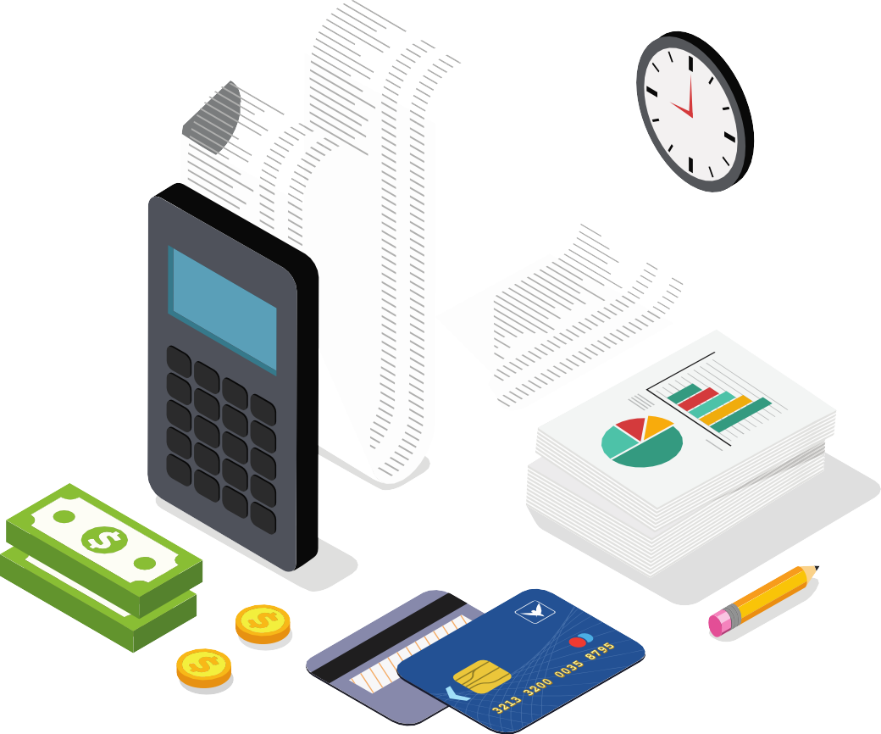

HOW TO MANAGE DEBT
SO IT DOESN’T MANAGE YOU
Keeping Finances Under Control
Presented by:
Helen Grays-Jones
Director of Community Relations

Slide 2
Meriwest credit union overview
Established: 1961
Community Expansion: Transitioned from serving SEG to a wider community in 1999, emphasizing inclusivity and service
Assets: $2.3 Billion
Membership: 82,000 members
Satisfaction: Over 90% of members rate us as extremely satisfied
Awards: Ranked Best Credit Union in the Bay Area for 4 consecutive years
Programs: Renowned locally and nationally for our world-class financial literacy program
Meriwest Credit Union believes it does not matter whether you are a youth or a senior citizen; the need for financial education spans all age groups.

Slide 3

Seminar Objectives
How to Manage Debt so it Doesn’t Manage You
What is DEBT?
What are the types of debt?
What is good debt? What is bad debt?
What are the benefits and costs?
The WARNING SIGNS
What are the warning signs of too much debt?
What does your credit report and score say about your debt?
How can you MANAGE YOUR DEBT?
How can you tackle the debt you have?
How can you avoid the pitfalls?
How can you stay out of debt and improve your credit?

Slide 4









What is debt?
Debt is an amount of money borrowed by one party from another. Debt is used by individuals as a method of making large purchases that they could not afford under normal circumstances. A debt arrangement gives the borrowing party permission to borrow money under the condition that it is to be paid back at a later date, usually with interest.

Slide 5

Types of Debt
Secured debt vs. Unsecured debt
Fixed interest rates vs. Variable interest rates
Installment credit vs.
Revolving credit

Slide 6

Types of Debt - Explained
Secured debt
Unsecured debt
Installment credit
Revolving credit
Car loan
Credit cards
Mortgage
Credit cards
Mortgage
Personal
loans
Student
loans
Cash
advances
Fixed
interest rates
Variable
interest rates
Car loan
Credit
cards
Mortgage
Payday loans

Slide 7
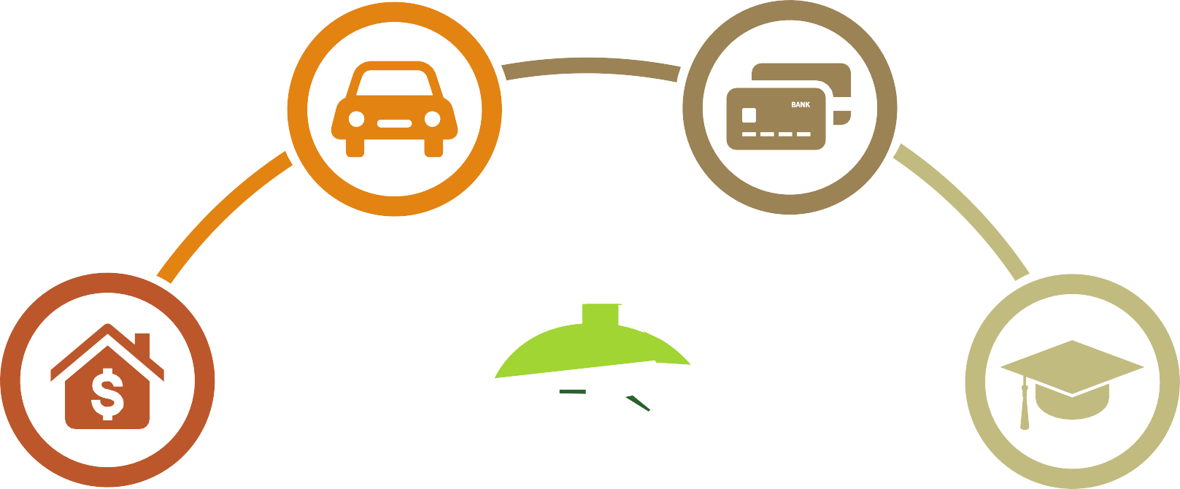
Breaking down debt
What are the most common forms used?
Vehicle loans
Credit cards
Mortgages
Student loans

Slide 8

The Pros and Cons of Credit

Slide 9







Is Using Credit an Advantage or a Disadvantage?

Slide 10
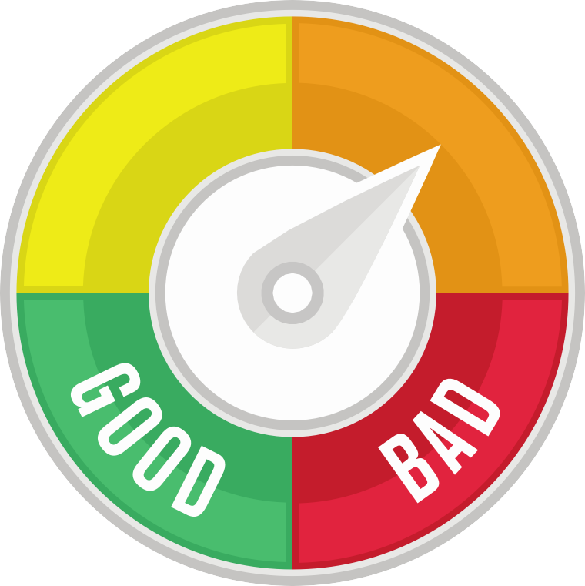
The Debt
Difference
What is good debt?
In general, good debt is that which increases your net worth
and/or helps you to generate value. Good debt allows you to manage your finances more effectively, to leverage your wealth, to buy things you need and to handle unforeseen emergencies.
What is bad debt?
Bad debt is that which does not increase wealth and/or is used to purchase goods or services that have no lasting value.

Slide 11



Bad Debt
Good Debt
vs.
Taking out a
mortgage
Borrowing to save time and money
Buying luxuries you can’t afford
Investing to increase future earnings
Carrying debt with high interest rates

Slide 12
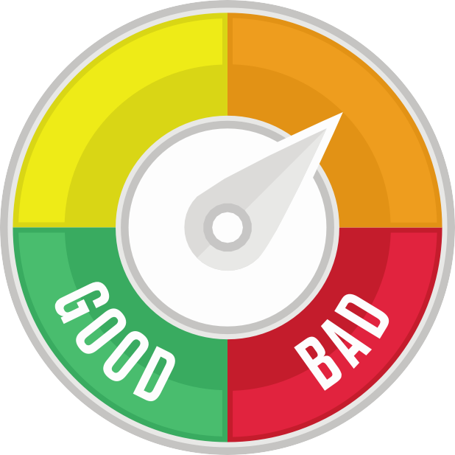

Good Debt vs. Bad Debt

Slide 13









































































































Costs of Debt: What should you consider?
What is the opportunity cost of taking on the debt?
Can I afford the purchase?
Will this diminish my ability to reach other financial goals?
Is it something
I really need or is it just a want?

Slide 14
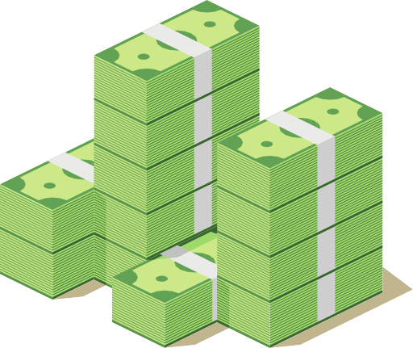

Costs of Debt: Credit Card Debt
$20,000
Credit card Balance at 18% interest
Make the minimum payment of 2% of the balance
each month
It will take you
30 years to pay off and cost you
$50,225 in interest
$20,000
in purchases will really cost you
$70,225
$20,000
$70,225

Slide 15
Costs of Credit:
The Effects of Interest Rates
Total Purchase Amount | $1,000 | $1,000 | $1,000
Credit Card APR (Annual Interest Rate) | 10% | 15% | 25%
Monthly Payment | $40 | $40 | $40
Number of Months to Pay Off Purchase | 29 | 31 | 36
Total Finance Charge | $126 | $207 | $427
Total Cost
$1,126
$1,207
$1,427

Slide 16
General warning signs about having too much debt
Unsure about what you owe
Spending more than you earn
Paying day-to-day bills with credit cards
Arguing with your
spouse about money
Skipping payments on some bills to pay others
Thinking about filing for bankruptcy
Making the minimum payments on credit cards
Creditors are calling you about late bills
Maxed out credit cards

Slide 17




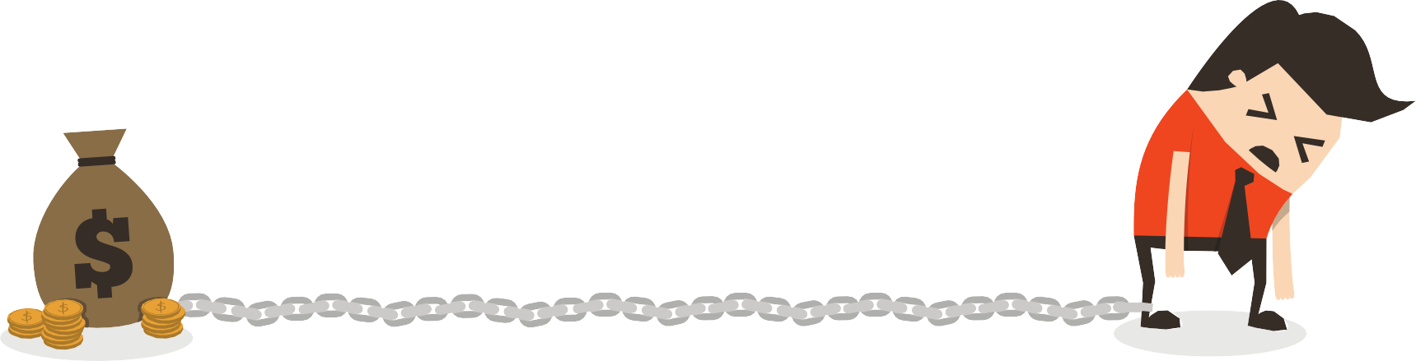


More specific signs you may have too much debt
You’re living paycheck to paycheck
Debt to income
ratio is more than 36%
You have no money set aside for retirement
Credit card balances exceed 10% of income
You have no emergency fund (3-6 months of income)

Slide 18




Your credit report- what is it?
A credit report is a record of your credit activities from the three major credit bureaus. It lists any credit-card accounts or loans you may have, the balances, and how regularly you make your payments. It also shows if any action has been taken against you because of unpaid bills.
Identifying
information
Credit
information
Inquiries
Public record
information

Slide 19

Your credit score- FICO® score
0-579
Extreme mishandling of credit, or
There is no established credit score and therefore, no credit history
720-850
Consistently responsible when it comes to managing their borrowing
Have a long history of no late payments
580-619
Have a significantly damaged credit history
May be the result of multiple defaults on different credit products
from several different lenders
680-720
Generally financially responsible when it comes to credit management
Most of their payments are made on time
620-679
Damaged credit history
Commonly have a credit record showing multiple late payments
May even show a loan default

Slide 20

How is your FICO Score determined?
Qualifying for Credit
30%
Amounts
Owed
10%
New Credit
15%
Length of Credit History
35%
Payment
History
10%
Credit Mix

Slide 21
How can you tackle the debt you have?
Make a game plan
Understand what you owe
Get organized
Eliminate what you can
Seek help and assistance
Lower your interest rates
Cut spending
Increase your income
Sell what you don’t need
Make a free, fun “to do” list
Don’t give up

Slide 22
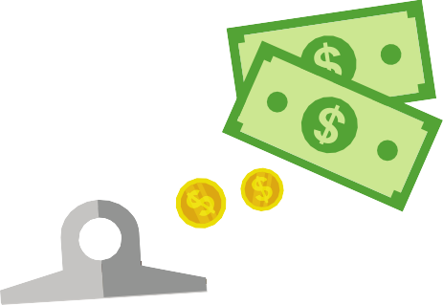


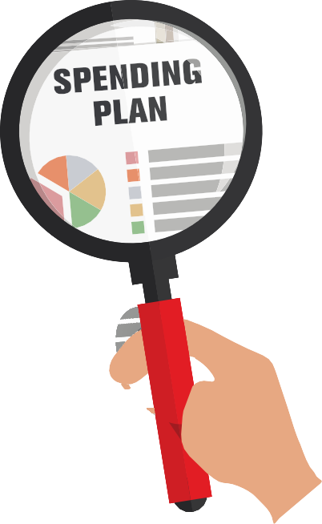

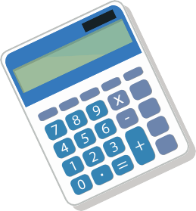


Tackling your debt
Make a Plan and Understand What you Owe

Slide 23
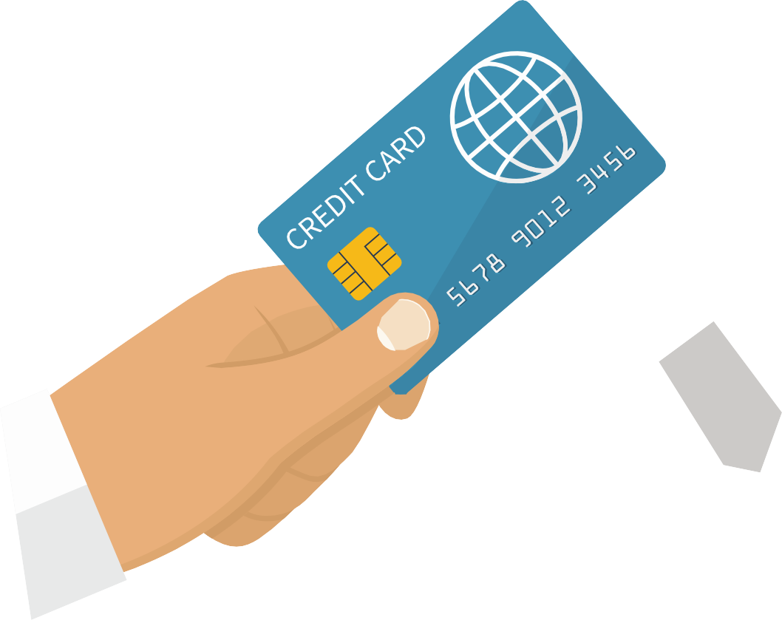

Tackling your debt
Get Organized and Eliminate What You Can

Slide 24






Tackling your debt
Seek Help and Assistance

Slide 25






Tackling your debt
Lower Your Interest Rates and Cut Spending

Slide 26






Tackling your debt
Increase Your Income

Slide 27













Tackling your debt
Sell What You Don’t Need and Make a Free, Fun “To Do” List

Slide 28

Tackling your debt
Don’t give up!

Slide 29




























How to Avoid the Pitfalls
Create a spending plan
Make more money
Set up an emergency fund
Save rather than spend
Plan ahead for periodic expenses
Don't use credit as an extension of your income

Slide 30
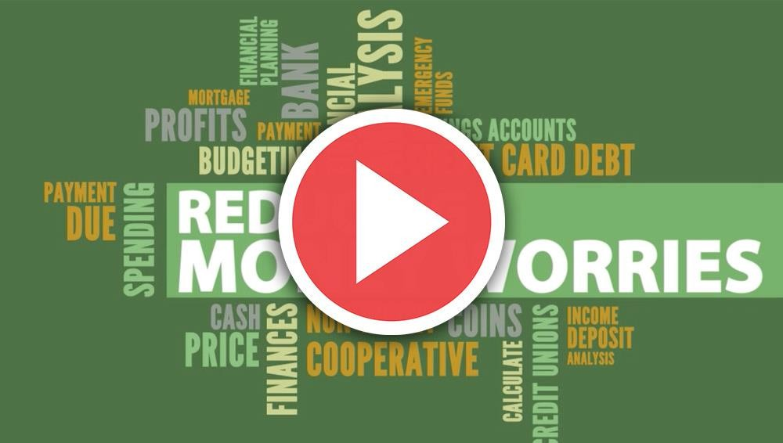
Video
Reducing Money Worries
Click Here to Play

Slide 31

It starts with a budget!

Slide 32
Specific
How can you stay out of debt?
Set
SMART
financial
goals
Measurable Adjustable Realistic
Time-Oriented

Slide 33
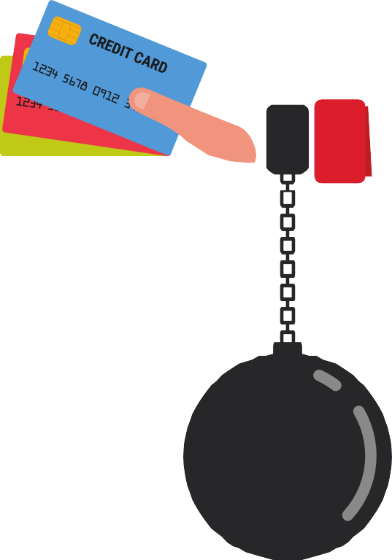
What else will help you stay out of debt?
Remember the agony
Don’t spend more than you earn
Track your spending
Wait for sales
Take care of your health

Slide 34
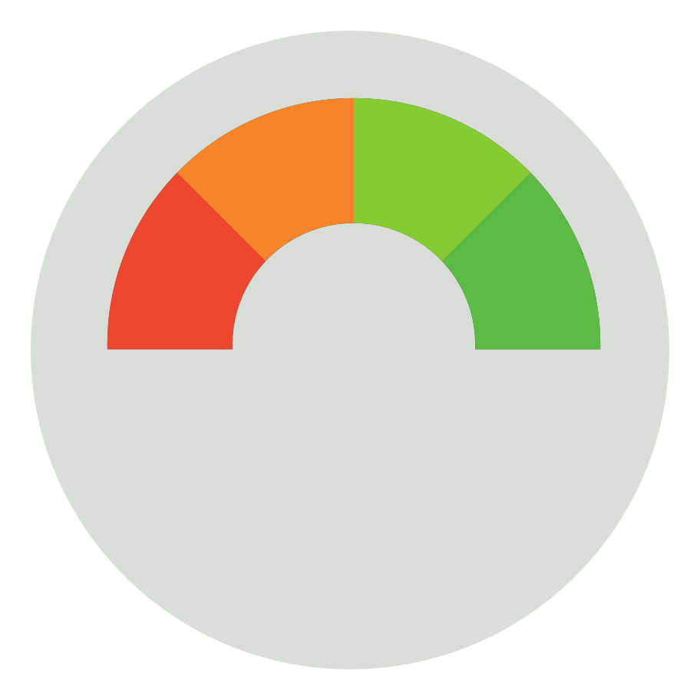



How can you improve your credit?
Arrange to catch up on your payments.
Pay your bills on time, all the time.
Check your credit report.
Pay down your debt.
Look into a secured credit card.
Avoid closing certain credit accounts.

Slide 35



How to protect your credit
Contact the three major credit bureaus and set Credit Freeze & Fraud Alert
Be sure to ask for a call back request, calling your phone number to be added as a call
Experian: 888-397-3742
Equifax: 800-525-6285
TransUnion: 800-916-8800
Social Security: 800—772-1213

Slide 36


What will you do with all the money you are no longer spending on your debt?
Invest
Find a hobby
Save
Give and serve

Slide 37












Remember…
Your
Credit Union
can help you with all of your
financial challenges.

Slide 38

Thank you
Connect With Us!
Facebook.com/MeriwestCreditUnion
Twitter.com/meriwest
Linkedin.com/company/meriwest
Instagram.com/meriwest
tiktok @meriwestcreditUnion

