Slide 1
Protect Yourself from Identity Theft
Presented by
Helen Grays-Jones
Director, Community Relations

Slide 2
Agenda
What is Identity Theft?
How do thieves obtain your data?
What steps can you take to protect your identity?
Credit Monitoring/Protection Services
Has your account been compromised?
What do you do if your identity is stolen?

Slide 3
Identity Theft
What is Identity Theft?

Slide 4
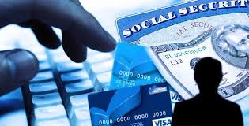
Definition of Identity Theft
The illegal use of someone else's personal identifying information (such as a Social Security number) in order to obtain money or credit.
Notes:
The short answer is that identity theft is a crime. Identity theft and identity fraud are terms used to refer to all types of crime in which someone wrongfully obtains and uses another person's personal data in some way that involves fraud or deception, typically for economic gain.
This presentation is intended to explain why you need to take precautions to protect yourself from identity theft. Unlike your fingerprints, which are unique to you and cannot be given to someone else for their use, your personal data especially your Social Security number, your bank account or credit card number, date of birth, mother’s maiden name and other valuable identifying data­ can be used, if they fall into the wrong hands, to personally profit at your expense.

Slide 5
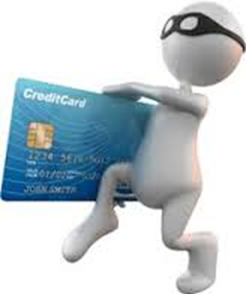
Identity Theft could affect…
Your Finances…bank accounts and credit cards
Notes:
Most people know that identity theft affects their financial accounts. This includes their bank accounts as well as their credit cards and ultimately their credit report and credit score.

Slide 6
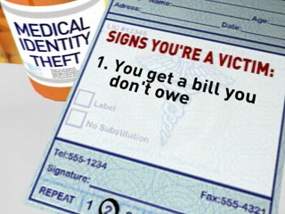
Identity Theft could affect…
Your Medical History
Notes:
The definition of medical identity theft is the fraudulent use of an individual’s personally identifiable information, such as name, Social Security number, and/or medical insurance identity number to obtain medical goods or services, or to fraudulently bill for medical goods or services using an unlawfully obtained medical identity.

Slide 7
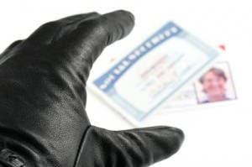
Identity Theft could affect…
Your access to government/social services
Notes:
Someone used Melissa’s SSN to file a tax return with Jackson Hewett to get an instant refund. Too bad for them that she owed back taxes and the IRS took the entire fraudulent instant refund to pay off her back taxes. The IRS did eventually figure it out but now there is a fraud alert on her IRS account and she has to use special PIN numbers and extra security questions and codes to access her tax information.

Slide 8
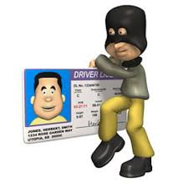
Identity Theft could affect…
Your criminal history
Notes:
Melissa’s friend had his identity stolen and the criminal went on a crime spree. Now when her friend gets pulled over for speeding & they run his info, they try to arrest him. He as to keep a file with him for the rest of his life with documents that prove it was not him so he won’t get arrested each time they pull him over.

Slide 9
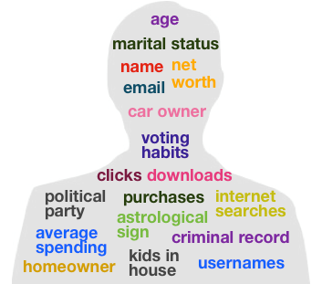
What information is at risk?
Social Security Numbers (SSN)
Name
Address
Date of Birth
Mother’s Maiden Name
Passwords and PIN’s

Slide 10
What can be done with this information?
Acquire new credit cards
Obtain new loans and even mortgages
Take over existing accounts
Access safe deposit boxes
Sell your assets
Obtain social welfare and hospital benefits
Someone can get a job in your name and SSN
Notes:
In the United States and Canada, for example, many people have reported that unauthorized persons have taken funds out of their bank or financial accounts, or, in the worst cases, taken over their identities altogether, running up vast debts and committing crimes while using the victim’s names. In many cases, a victim's losses may include not only out-of-pocket financial losses, but substantial additional financial costs associated with trying to restore his or her reputation in the community and correcting erroneous information for which the criminal is responsible.
Here are some examples-no need to read all of them:
Take over existing accounts = Someone stole Melissa’s rent check out of her landlord’s mailbox and then tried to use the routing information on the bottom to try & deposit funds into a pre-paid VISA account. They also used chemicals to erase the ink and re-wrote the original check to themselves for $450.
Someone can get a job in your name and SSN = Melissa’s 10 year old nephew has 34 people currently using his SSN for work in Southern California.
Central District of California. A woman pleaded guilty to federal charges of using a stolen Social Security number to obtain thousands of dollars in credit and then filing for bankruptcy in the name of her victim. More recently, a man was indicted, pleaded guilty to federal charges and was sentenced to 27 months imprisonment for obtaining private bank account information about an insurance company's policyholders and using that information to deposit $764,000 in counterfeit checks into a bank account he established.
These are people who got caught. Every year hundreds of thousands of identity thefts occur with NO ONE being caught or convicted!

Slide 11
Identity Theft
How do thieves obtain your data?

Slide 12
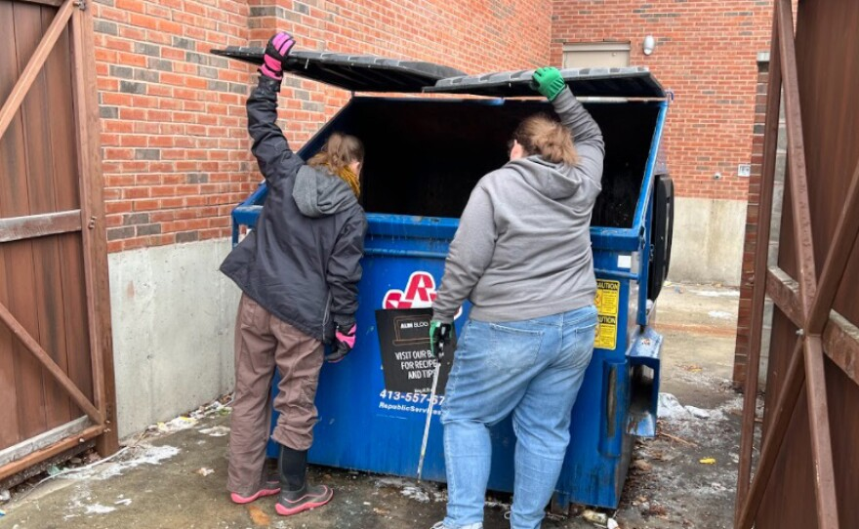
How do thieves obtain your data?
They look for your personal data by going through your trash or the trash of businesses (aka “Dumpster Diving”)
Notes:
Some criminals engage in "dumpster diving" ­ going through your garbage cans or a communal dumpster or trash bin -- to obtain copies of checks, credit card or bank statements, or other records that typically bear your name, address, and even your telephone number. These types of records make it easier for criminals to get control over accounts in your name and assume your identity.

Slide 13

How do thieves obtain your data?
“Shoulder Surfing”
Notes:
Many people do not realize how easily criminals can obtain our personal data without having to break into our homes.
In public places, for example, criminals may engage in "shoulder surfing" ­ watching you from a nearby location as you punch in your credit card number ­or listen in on your conversation if you give your credit-card number over the telephone to a hotel or rental car company.
Even the area near your home or office may not be secure.

Slide 14

How do thieves obtain your data?
Steal wallets and purses

Slide 15
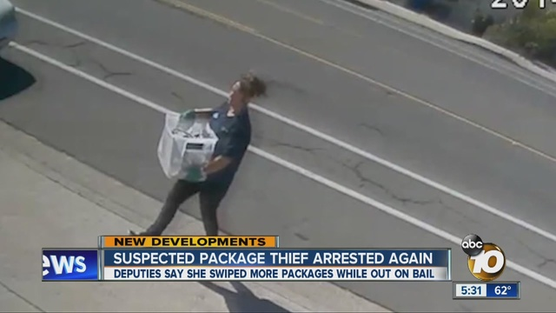
How do thieves obtain your data?
Steal your mail
Notes:
Steal your mail = This is how they got Melissa…She ended up buying a locked mailbox and so did her landlord
If you receive applications for "preapproved" credit cards in the mail, but discard them without tearing up the enclosed materials, criminals may retrieve them and try to activate the cards for their use without your knowledge.

Slide 16

How do thieves obtain your data?
Complete a “change of address form” to divert your mail to another location
Notes:
Also, if your mail is delivered to a place where others have ready access to it, criminals may simply intercept and redirect your mail to another location.

Slide 17
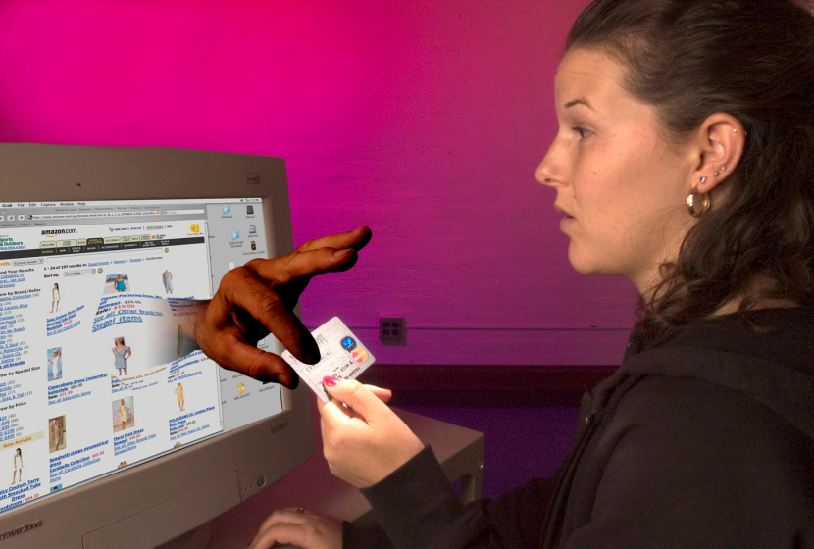
How do thieves obtain your data?
Use personal information that you share
on the Internet

Slide 18

How do thieves obtain your data?
Pose as legitimate companies that you do business with, in order to get your personal information (aka “Phishing”)
Meriwest would NEVER ask you to disclose any of your personal information in an e-mail.
Notes:
They pose as legitimate companies or government agencies that you do business with in order to get your personal information. AKA “Phishing”

Slide 19
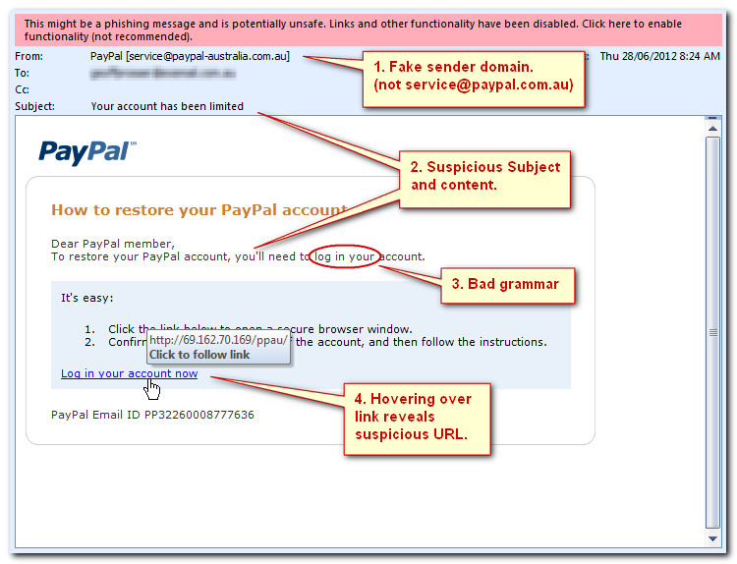

Slide 20
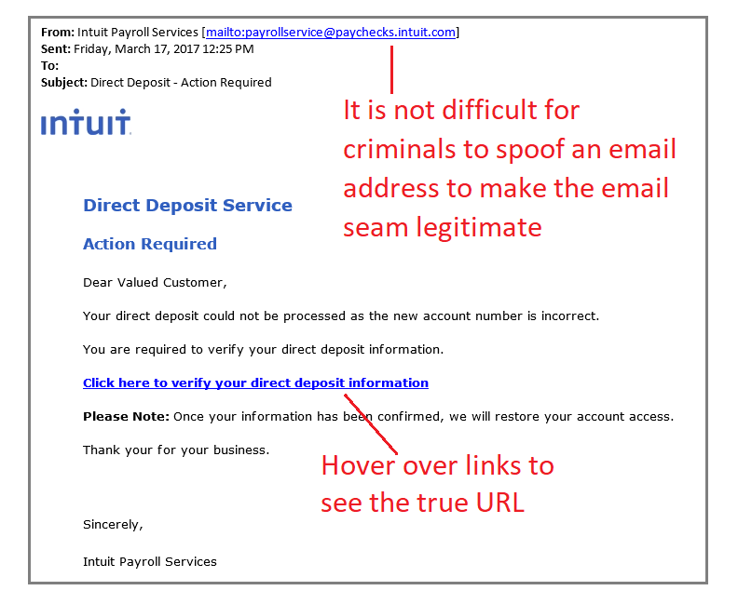
Notes:
A familiar attempt to get at your hard-earned paycheck is resurfacing, says the FBI. The organization recently released a Public Service Announcement warning that cybercriminals are again targeting online payroll accounts for employees who use direct deposit, particularly those working in education, healthcare, and commercial airway transportation. The Better Business Bureau is also echoing the warning to consumers. The direct deposit scam is nothing new, but it’s back with a vengeance.

Slide 21
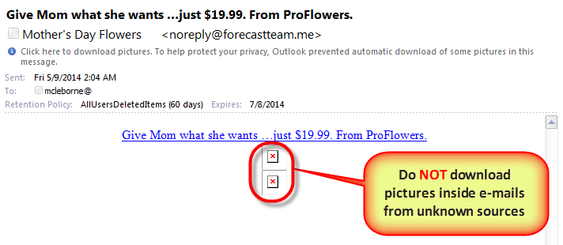

Slide 22
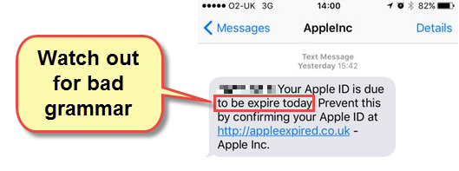
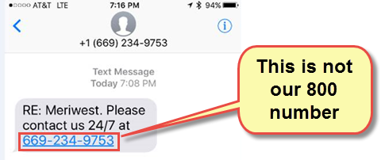
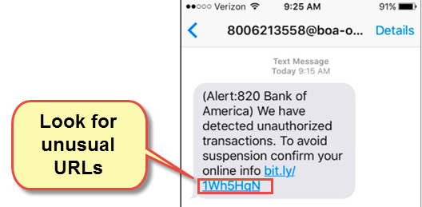
Text Message

Slide 23
Tips for Text Messages
Do NOT open and/or download attachments from an unknown sender
Do NOT open or respond to unsolicited (spam) texts
Do NOT click on embedded links contained in a message from unknown external senders
Consider the content of the message. Does the request make sense?
When in doubt, contact the company or person directly to verify.

Slide 24

How do thieves obtain your data?
Place a virus on your computer that searches for account information that is followed by a PIN and/or a password
Online banking
Biller websites

Slide 25
Identity Theft
How to Protect your Identity

Slide 26
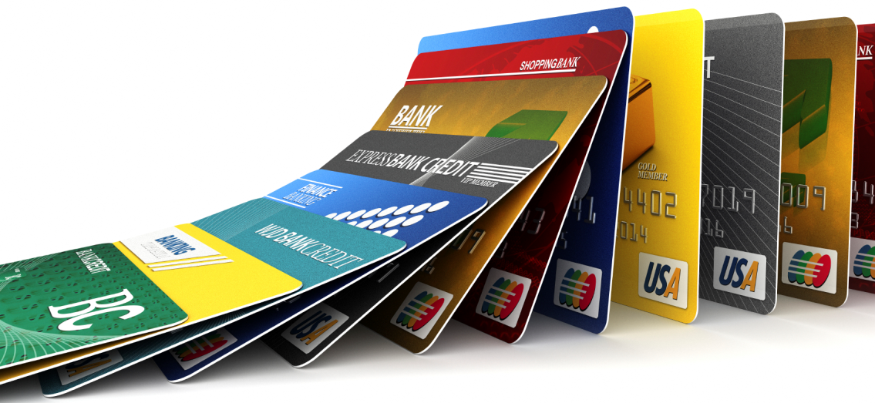

How to Protect your Identity
Sign up for only a few credit cards so that it is easy to monitor them.
Never just destroy a card you don't plan on using again.
Make sure you actually close out the account.

Slide 27

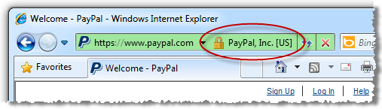
How to Protect your Identity
Make sure that all online purchases are made through a reputable site
That the site is safe and secure
Notes:
Such sites will post Trust-e symbol on their pages. All secure sites have URLs that begin with "[https" https"] and have a privacy policy. Additionally, you may want to reserve one particular credit card for online purchases so that you don't put more than one card at risk.

Slide 28
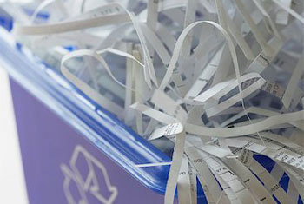
How to Protect your Identity
Purchase a shredder.
Destroy everything you want to throw away that has your personal financial information on it.
This includes verified bank statements, bills, receipts, and pre-approval credit offers.

Slide 29

How to Protect your Identity
Opt-out of ALL pre-approved credit offers
Call toll free 1 (888) 5-OPT-OUT
Visit www.optoutprescreen.com

Slide 30

How to Protect your Identity
Make a habit of verifying your bank and credit card statements with your receipts before shredding them.
Notes:
Make a habit of verifying your bank statements with your receipts before shredding the receipts.
Staying abreast of your spending will allow you to spot and stop personal information fraud sooner than later.

Slide 31

How to Protect your Identity
You can legally request one free credit report per year from each major reporting agency
Experian
Transunion
Equifax
Can help you keep track
Alert you to any negative factors
Visit: www.AnnualCreditReport.com
If you find an error, contact the credit issuer immediately
Notes:
One of the most important pieces of knowledge you have in your arsenal as a consumer is that you can legally request one free credit report per year from each of the major credit reporting agencies.
The three credit reporting agencies are Experian, Transunion and Equifax.
These reports can help you keep track of long-term trends in your credit and can alert you to any negative factors you may be unaware of.
Visit AnnualCreditReport.com
If you find an error in a report, contact the credit issuer to correct the mistake with the reporting agencies.

Slide 32

How to Protect your Identity
Ensure your computer has appropriate anti-virus software.
Notes:
Update any changes of address immediately if you move, including all the credit card companies you use.
You don't want your personal information going to your old address and possibly the wrong hands.

Slide 33

How to Protect your Identity
Update any changes of address immediately if you move, including all the credit card companies you use.
Notes:
Update any changes of address immediately if you move, including all the credit card companies you use.
You don't want your personal information going to your old address and possibly the wrong hands.

Slide 34
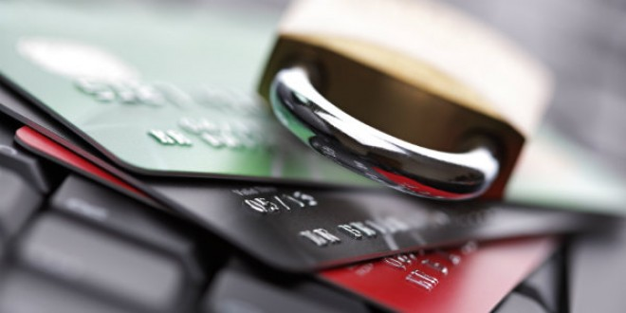
How to Protect your Identity
Secure your personal information by guarding your Social Security card and number, and disclosing it only when it is essential.
Notes:
Secure your personal information by guarding your Social Security card and number, and disclosing it only when it is essential.
If you are suspicious about why it is requested, don't be afraid to question it, and if you don't feel comfortable revealing certain information, don't.

Slide 35

How to Protect your Identity
Don’t give out personal information!
Over the phone
Through the mail
Over the Internet
Notes:
Don’t give out personal information on the phone, through the mail, or on the Internet unless you initiate the contact or know the individual who initiated the contact. Thieves will pose as bank representatives, Internet service providers, government agents, and even ex-boyfriends or -girlfriends to get you to reveal personal information.
Never release your Social Security, credit card, or bank account numbers over the phone, unless with a bank that you have contacted.
If someone calls in, get their information and then call your bank back through your usual method or phone contact in order to verify that the request was legitimate.

Slide 36
Identity Theft
Credit Monitoring / Protection Services
Notes:
Monitoring is good. Catherine, while standing in line at Disney Land, Credit Karma alerted her that she recently applied for credit. She thought…that is odd…I’m at Disney Land…not applying for credit. After she got back from her trip, she pulled her credit report and found someone was using her SSN. They opened up an account with PG&E and Comcast, they rented a house, applied for a mortgage loan, got a personal unsecured loan, and got a pay day loan…all in ONE weekend. Without Credit Karma who knows when she would have found out and how much worse the damage could have been. However, after the fact, she wished that she also had restoration services. It took her over two years to clean up the mess!

Slide 37

Credit Monitoring / Protection Services
FREE credit monitoring: www.creditkarma.com
Only monitors your Transunion Credit Report
For a monthly fee, Credit Protection services will:
Monitor your credit report daily
Give you free access to your credit reports
Provide email alerts of changes in your credit file
Take action on your behalf in cases of identity theft
Notes:
One of the most important pieces of knowledge you have in your arsenal as a consumer is that you can legally request one free credit report per year from each of the major credit reporting agencies.
The three credit reporting agencies are Experian, Transunion and Equifax.
These reports can help you keep track of long-term trends in your credit and can alert you to any negative factors you may be unaware of.
Visit AnnualCreditReport.com
If you find an error in a report, contact the credit issuer to correct the mistake with the reporting agencies.

Slide 38
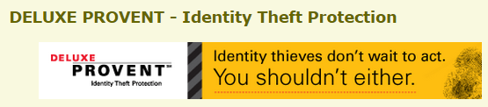
Credit Monitoring / Protection Services
Meriwest recommends
Deluxe Provent provides:
Prevention
Detection
Restoration
www.meriwest.com search for “identity theft"
Notes:
One of the most important pieces of knowledge you have in your arsenal as a consumer is that you can legally request one free credit report per year from each of the major credit reporting agencies.
The three credit reporting agencies are Experian, Transunion and Equifax.
These reports can help you keep track of long-term trends in your credit and can alert you to any negative factors you may be unaware of.
Visit AnnualCreditReport.com
If you find an error in a report, contact the credit issuer to correct the mistake with the reporting agencies.

Slide 39
Credit Monitoring / Protection Services
Easy Enrollment!
Visit www.deluxeprovent.ezshield.com to view protection options
When registering, use
Meriwest’s Routing Number – 321176833
Follow the easy enrollment steps to activate your membership
Notes:
One of the most important pieces of knowledge you have in your arsenal as a consumer is that you can legally request one free credit report per year from each of the major credit reporting agencies.
The three credit reporting agencies are Experian, Transunion and Equifax.
These reports can help you keep track of long-term trends in your credit and can alert you to any negative factors you may be unaware of.
Visit AnnualCreditReport.com
If you find an error in a report, contact the credit issuer to correct the mistake with the reporting agencies.

Slide 40
Identity Theft
Has your account been compromised?
Notes:
Monitoring is good. Catherine, while standing in line at Disney Land, Credit Karma alerted her that she recently applied for credit. She thought…that is odd…I’m at Disney Land…not applying for credit. After she got back from her trip, she pulled her credit report and found someone was using her SSN. They opened up an account with PG&E and Comcast, they rented a house, applied for a mortgage loan, got a personal unsecured loan, and got a pay day loan…all in ONE weekend. Without Credit Karma who knows when she would have found out and how much worse the damage could have been. However, after the fact, she wished that she also had restoration services. It took her over two years to clean up the mess!

Slide 41

Has your account been compromised?
Transactions on your checking or savings accounts you did not authorize.
Notes:
Share Catherine’s Visa/Debit card going to Hawaii without her!
She got paid on a Friday – Went to Starbucks on Monday and her card was declined
She logged into her online banking account and found her account was negative
Looking through the transactions, she noticed that the location was Hawaii…she has never been to Hawaii
The criminal started with very small purchases at convenience stores, then tried $500 at Sears and then $1200 at Best Buy. As each transaction was approved, they tried again for more and more money.
Somehow the criminals skimmed her card info and created a new card.

Slide 42
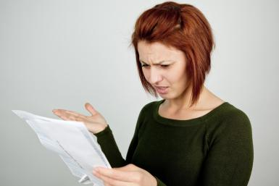
Has your account been compromised?
Transactions on your credit cards that you did not authorize.

Slide 43
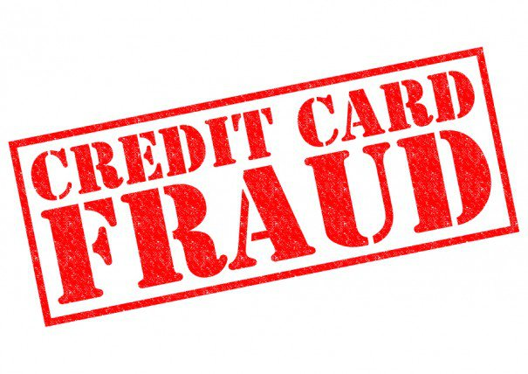
Has your account been compromised?
Loans on your credit report for which you did not apply.

Slide 44

Has your account been compromised?
Calls from collection agencies for loans which you did not apply.

Slide 45
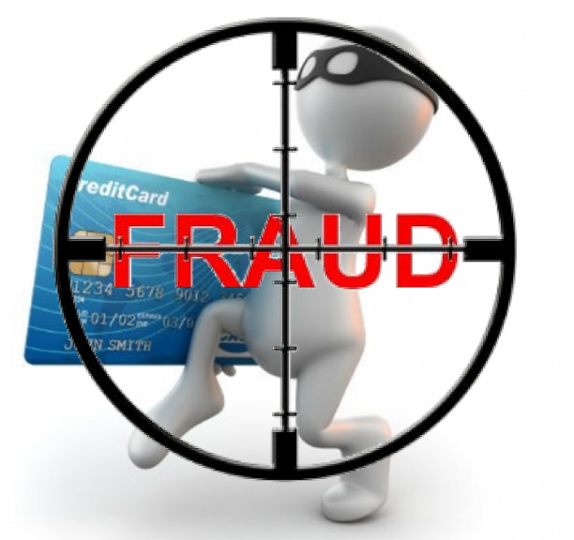
Do creditors try and protect you?
The credit card companies watch for activity that is out of the ordinary.
Have you ever had a call from the card company asking if you recall making a specific transaction?
Notes:
Example: All your transactions are minor and performed in your community. Suddenly, there are a lot of large dollar activities on your card that are preformed out of town. On occasion, the card company will call to check on this activity.

Slide 46
Identity Theft
What do you do if your identity is stolen?

Slide 47



What do you do if your identity is stolen?
Contact the three major credit bureaus and set a Fraud Alert
Experian: 888-397-3742
Equifax: 800-525-6285
TransUnion: 800-916-8800
Notes:
You can place a fraud alert on your credit report. This will tell creditors to contact you before opening any new accounts. Remember the identity theft victims that usually suffer the most financial impact are those that the perpetrator opens new accounts in their name.

Slide 48

What do you do if your identity is stolen?
File an Identity Theft Report with the Federal Trade Commission
www.consumer.ftc.gov
Notes:
File a complaint with the Federal Trade Commission. The Identity Theft and Assumption Deterrence Act establishes the Federal Trade Commission (FTC) as a central agency to act as a clearinghouse for complaints. You will need to file a complaint with the FTC by either calling their Identity Theft Hotline: (877) IDTHEFT (877-438-4338).

Slide 49

What do you do if your identity is stolen?
File a police report
Notes:
File a complaint with your local law enforcement agency. Although federal agencies may be involved, your local agency will play an integral part in the investigation. Additionally, your creditors will likely ask for a police report.

Slide 50
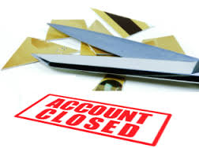
What do you do if your identity is stolen?
Contact all creditors involved
Close the affected accounts
Notes:
Close your financial accounts. It is essential to close any financial accounts that may have been compromised or opened by the perpetrator. Not doing so is likely to increase the financial losses that you may suffer.

Slide 51
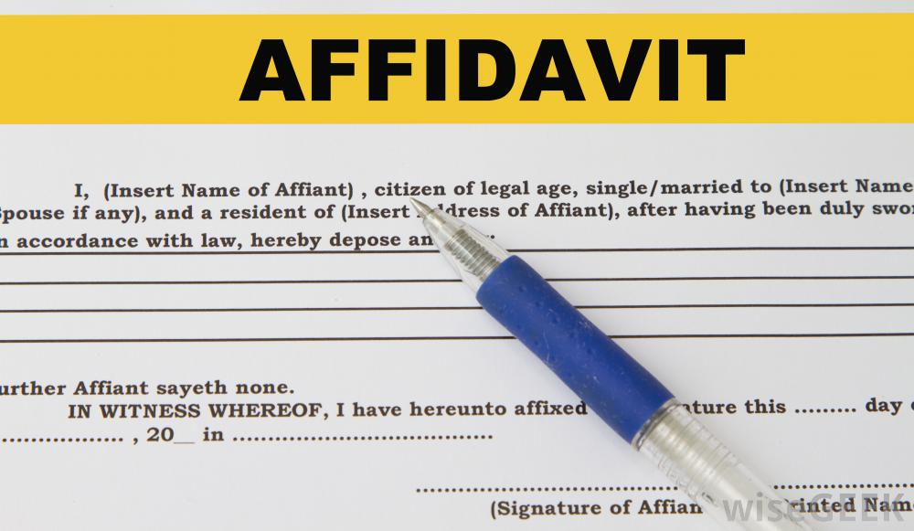
What do you do if your identity is stolen?
You will need to file an affidavit of forgery and/or identity theft with each institution
(Sample only…actual document may vary)
Notes:
These items certify to the institution that you have been a victim and the transactions were not performed by you or with your knowledge or permission.

Slide 52

What do you do if your identity is stolen?
Keep a record of everyone you spoke with and details of the conversation
Notes:
Record the dates and times and who you spoke to and note what took place in the conversation. Did the bank promise to freeze your accounts? Do you need to sign an affidavit?

Slide 53
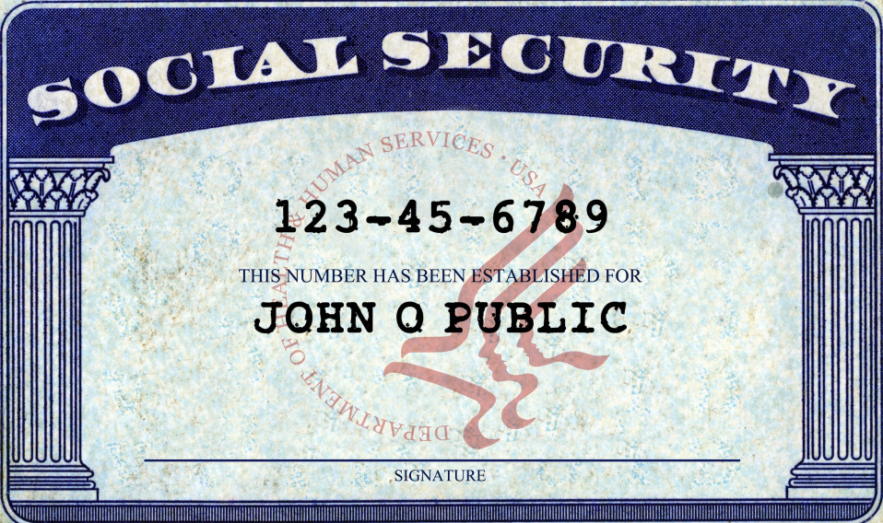
Should you get a new Social Security Number?
Very rare
Must prove you’ve done all you can to repair your identity
Must also prove you are still being disadvantaged by the fraud
Notes:
If you have done all you can to fix the problems resulting from misuse of your Social Security number and someone still is using your number, Social Security may assign you a new number.
You must provide evidence that you are still being disadvantaged by the misuse.

Slide 54

What’s next?
In many cases the financial institutions will reimburse their clients for the losses but only if you report them immediately
It takes time, patience, and paperwork
Notes:
In many cases the financial Institutions will reimburse their clients for the losses they have incurred due to forged or fraudulent transactions on checking and savings accounts.
This includes electronic transactions done on the internet and at ATM’s.
It takes time, patience, and paperwork.

Slide 55
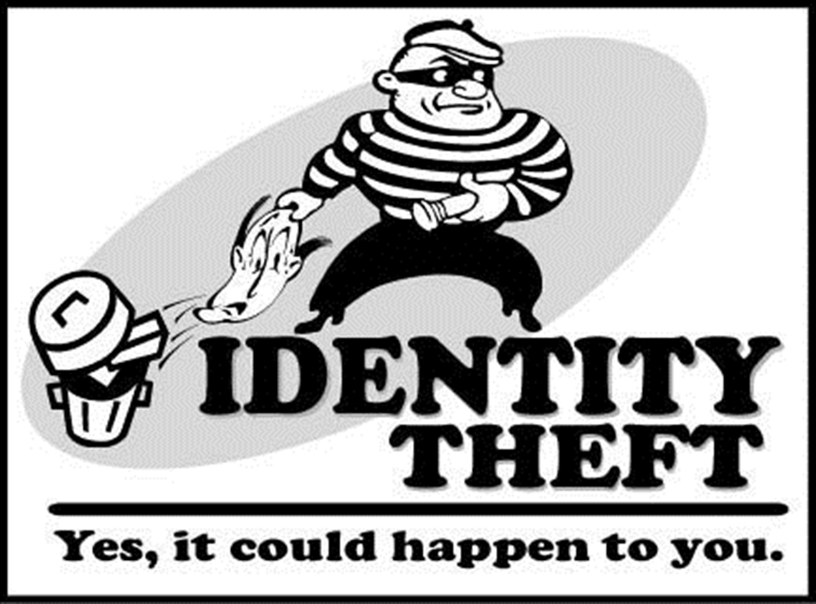
Summary
Monitor your credit report
Don’t give out your personal information
Protect your credit/debit cards
Protect your mailbox
Keep personal info in a safe place at home
Don’t be caught by “Phishing”

Slide 56
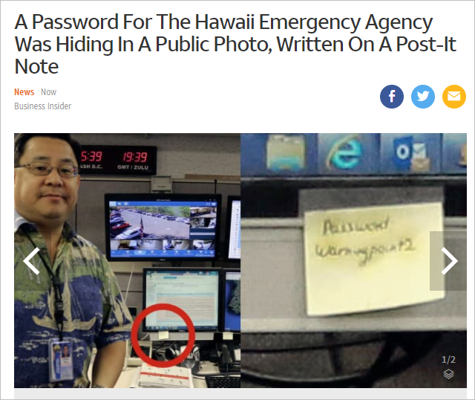
Don’t Let this be You!

Slide 57

Thank you
Connect With Us!
Facebook.com/MeriwestCreditUnion
Twitter.com/meriwest
Linkedin.com/company/meriwest
Instagram.com/meriwest
TikTok @meriwestcreditUnion

