Slide 1


Resume writing skills
Helen Grays-Jones, Director of community relations

Slide 2
Creating a resume that opens doors
Your first impression on paper – a resume is your personal brand snapshot.
Show, don’t just tell – highlight accomplishments with measurable results.
Tailor for impact – customize to match the role and industry.
Keep it clear – concise, easy to read, and free of clutter.

Slide 3

What is a resume?
A tool that is used to attract your ideal work
Highlights pertinent information:
Skills
Experience
Achievements
Only opens the door

Slide 4
Resumes in the 21st century
What employers are looking for in a resume has changed
Employers are inundated with resumes
Average resume scanned in 20 seconds sometimes only by a computer
Key words are extremely important – make sure they are spelled correctly

Slide 5

How to Make yourself standout
On merit & good work alone?
Unfortunately…No
You must sell yourself
What is your advantage over the competition?
What do you have to offer?
What value would you add?

Slide 6
A well-designed resume
Paints a positive and factual picture of you professionally
Sets a positive tone for the interview
Guides the interviewer in what to ask
Influences others who approve the hiring decision

Slide 7
Getting started
Gather Information
Performance Reviews
Status Reports
Customer Comments
Sample Resumes
Open Position Requirements

Slide 8

All resumes should include
Name & Contact Info.
Summary including key words
List professional experience including accomplishments

Slide 9
Can also include
Education Section
Start with highest completed degree
Do not need to include dates
Professional Development
Include supplementary training & certificates
Community Involvement
What you do in your unpaid time may say more about you then what you do for employment
Certifications, publications, patents, languages, etc.

Slide 10
references
Have a separate form listing references
Include information about the reference:
Name
Job Title
Phone Number
Email
Background information regarding your professional relationship (i.e., how you worked with this person and why they would be a good professional reference)
Do not include this information on the actual resume

Slide 11
First things first
Name
Top middle or top right corner
Bold & larger font
Contact Information
Address - Spell out name of state
Phone – Must be able to talk
Email - Must be appropriate

Slide 12
Summary section
Include at top of resume
3-4 brief statements as to why you are the right person for the job
Anything that makes you qualified for the job
Experience
Credentials
Expertise
Personal Values
Work Ethics
Background
Entice the reader to finish reviewing your resume

Slide 13
Summary section continued
Include columns of additional skills in bullet form
Should be specific to the target company/position
Remember – Resumes may be scanned for key words
Sample Key Words Summary Section
Strong Communicator
Relationship builder
Team Mentorship
Risk Management
Process Optimization
Exceeds Targets
Growth Mindset
Highly Adaptable

Slide 14
Professional Experience section
List most recent company worked for
Use years only – no months
One-line description of the company (optional - as space allows)
Most recent job title
Brief description of duties
Include 3-5 accomplishment statements

Slide 15
Highlight accomplishments
Best evidence of your skills
Illustrates your capabilities
Potential indicator of future potential
Strengthen your resume
Help distinguish you from other candidates
Can use bold headlines to highlight the accomplishment

Slide 16

Examples of accomplishments
Projects you worked on
Problems you solved
Outcomes of your work
Results you achieved
Programs you implemented

Slide 17
Consider the following questions
Did you increase sales, reduce costs, save time or money?
Did you get promoted? Why? Within what timeframe?
What was something you created or built or an idea or concept you developed?
Did you improve customer service, increase the client base, and/or support the sales effort?
Did you receive any awards or letters of commendation?
Did you improve efficiency?
Did you consistently meet deadlines for key projects?

Slide 18
Sample accomplishment
“Reduced excess supply orders by developing a new process to monitor and track current inventory saving the company over $5,000 in the first year alone.”

Slide 19
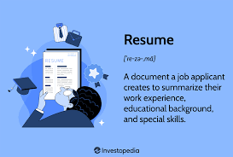
Resume format
Chronological Format
Functional Resume
Combination Resume

Slide 20
Chronological format
The traditional resume
Most common form
Highlights employment history
Reverse chronological order

Slide 21
Chronological format – best used when
Looking for work in the same field
Work history documents significant career growth with increasing responsibility
Transferring skills to the same industry (i.e., you have been a bank teller and are applying sales associate position at a bank)

Slide 22
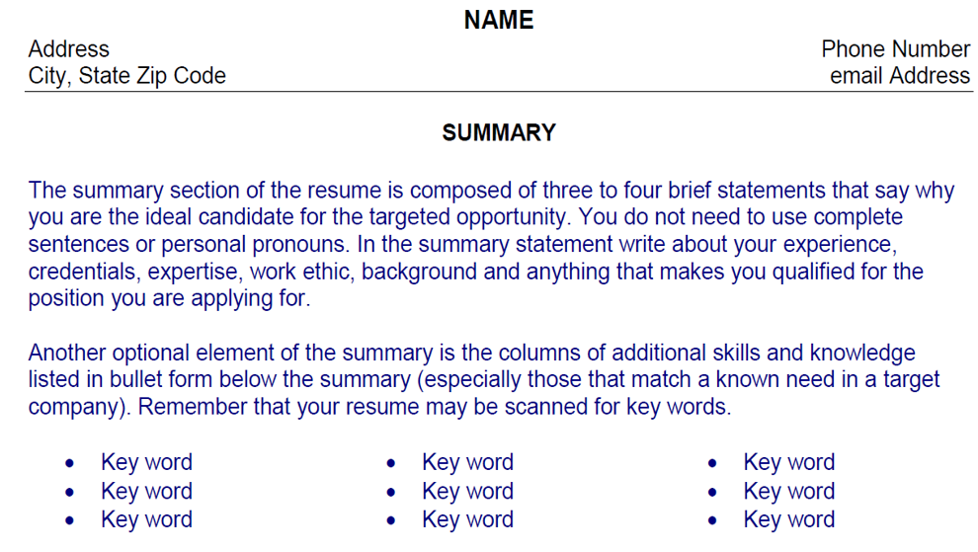
Sample chronological resume

Slide 23
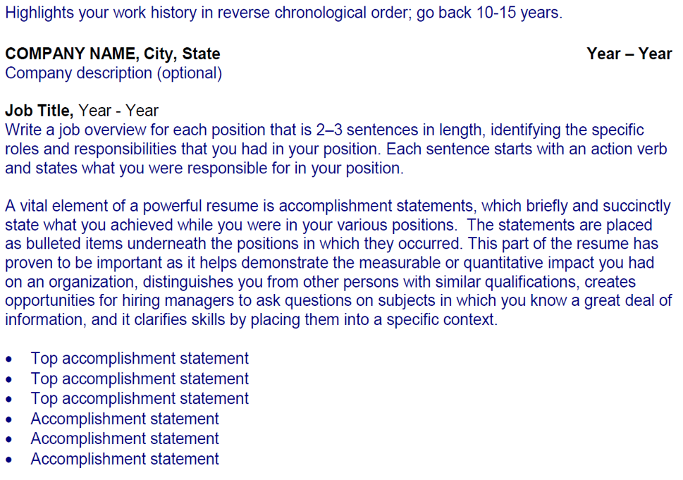
Professional experience

Slide 24
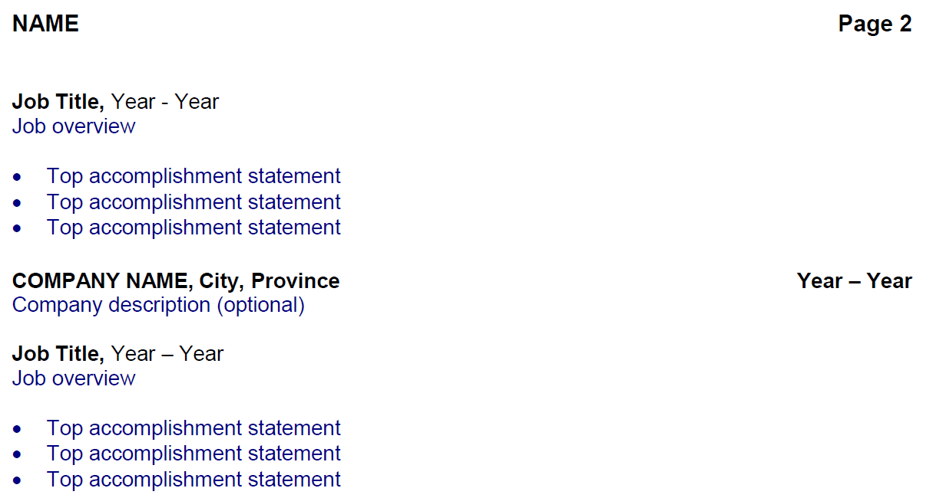
Professional experience continued

Slide 25
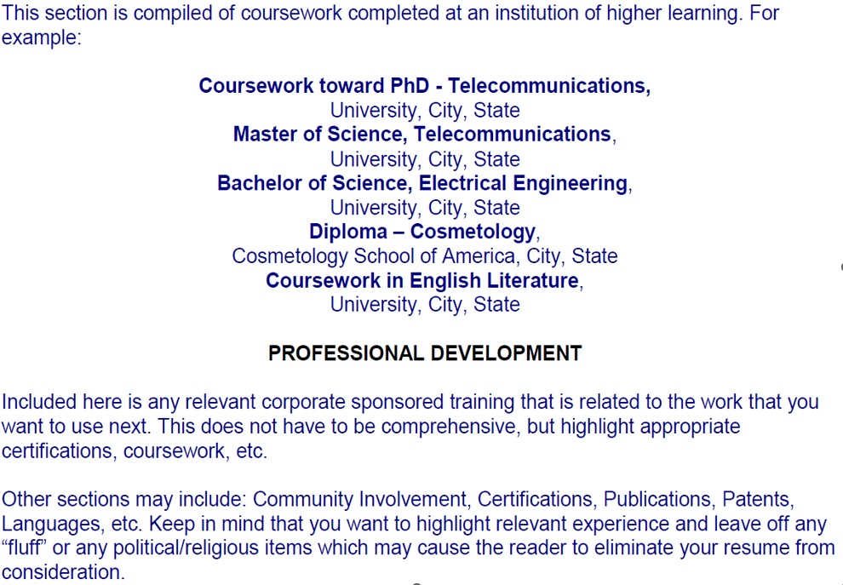
education

Slide 26
Functional resume
Highlights skills, knowledge, and abilities (SKA)
Does not focus on dates
Uses accomplishments to express expertise
Use when:
Have minimal or no direct experience
SKA not reflected in recent work history
Entry-level or re-entering job market
Inconsistent work history

Slide 27
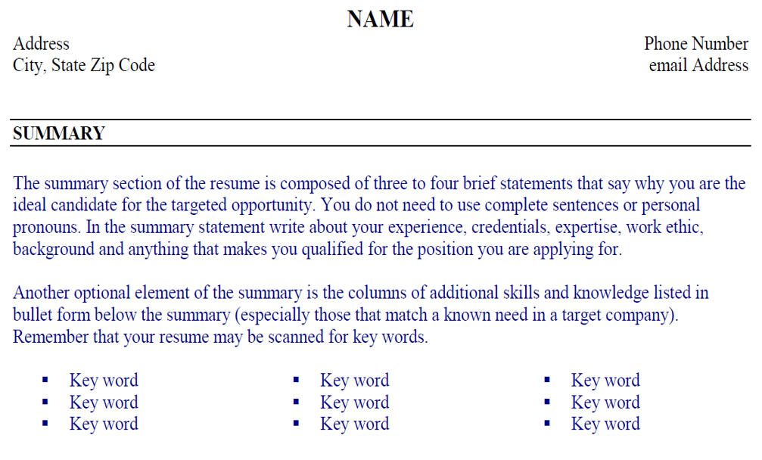
Sample functional resume

Slide 28
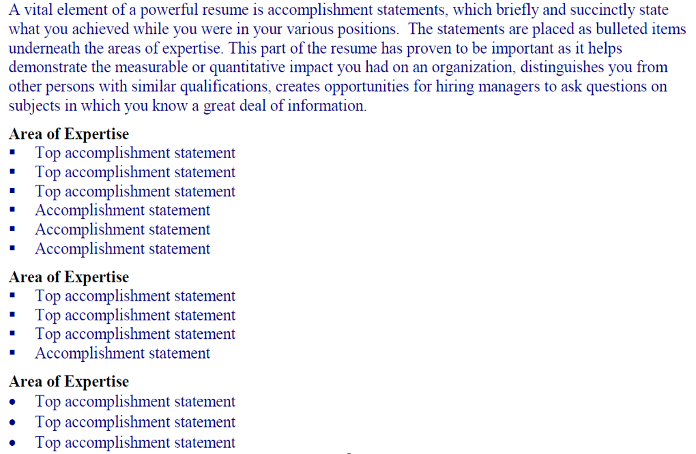
Professional accomplishments

Slide 29
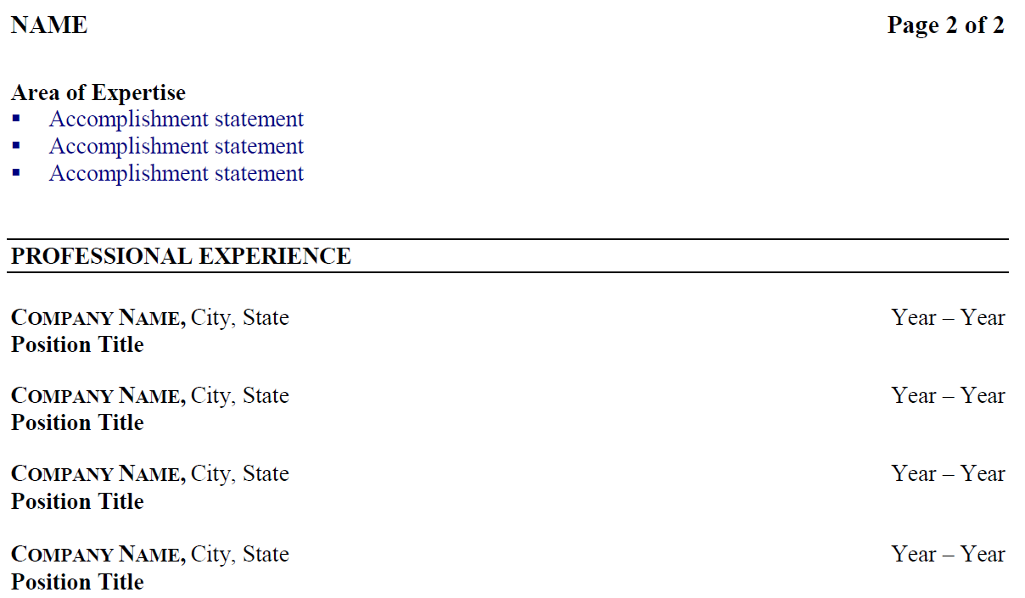
Professional accomplishments continued

Slide 30
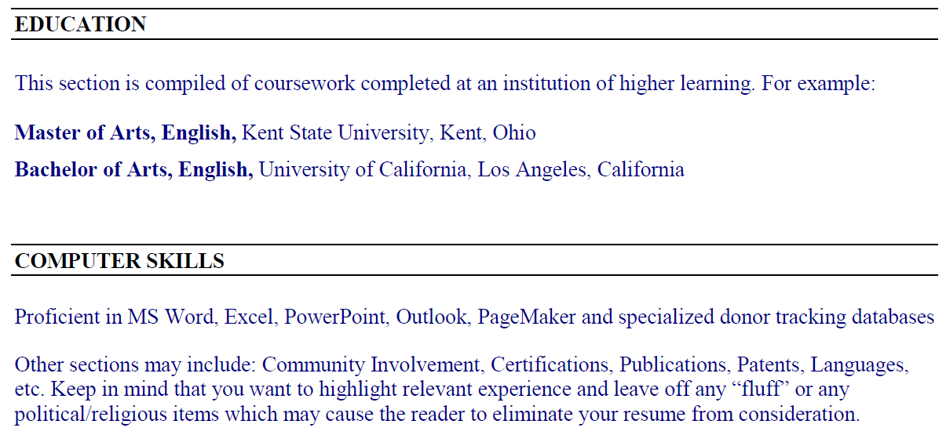
Education and skills

Slide 31
Combination resume
Uses parts of both
First highlight applicable SKA
Then list job history in chronological order
Use little to no detail about each job
Use when:
No actual work experience in the job you are applying for

Slide 32
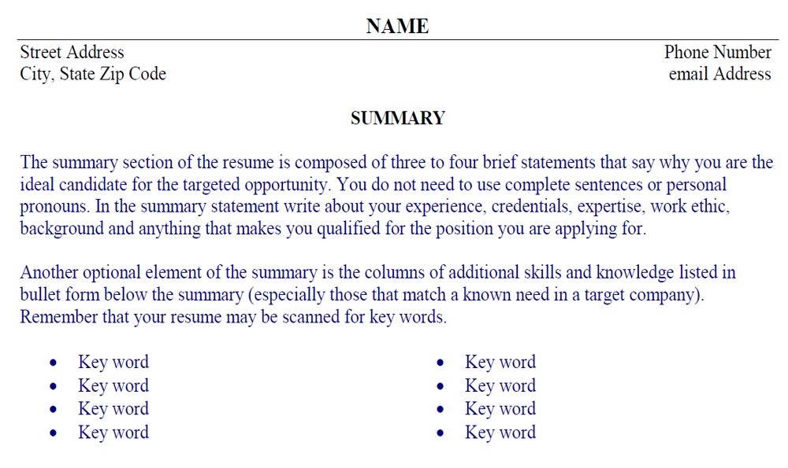
Sample combination resume

Slide 33
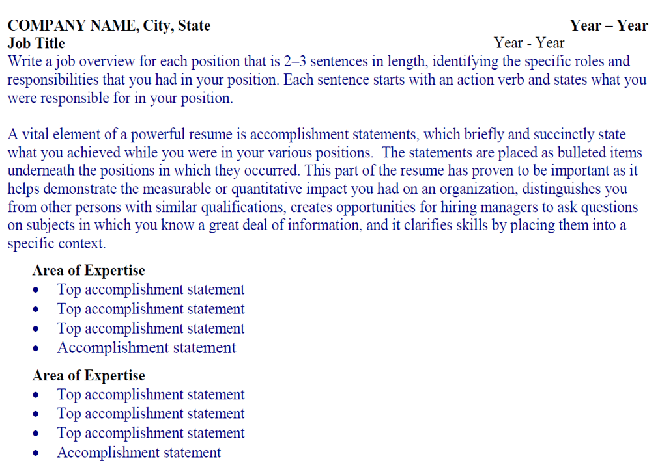
Professional experience

Slide 34
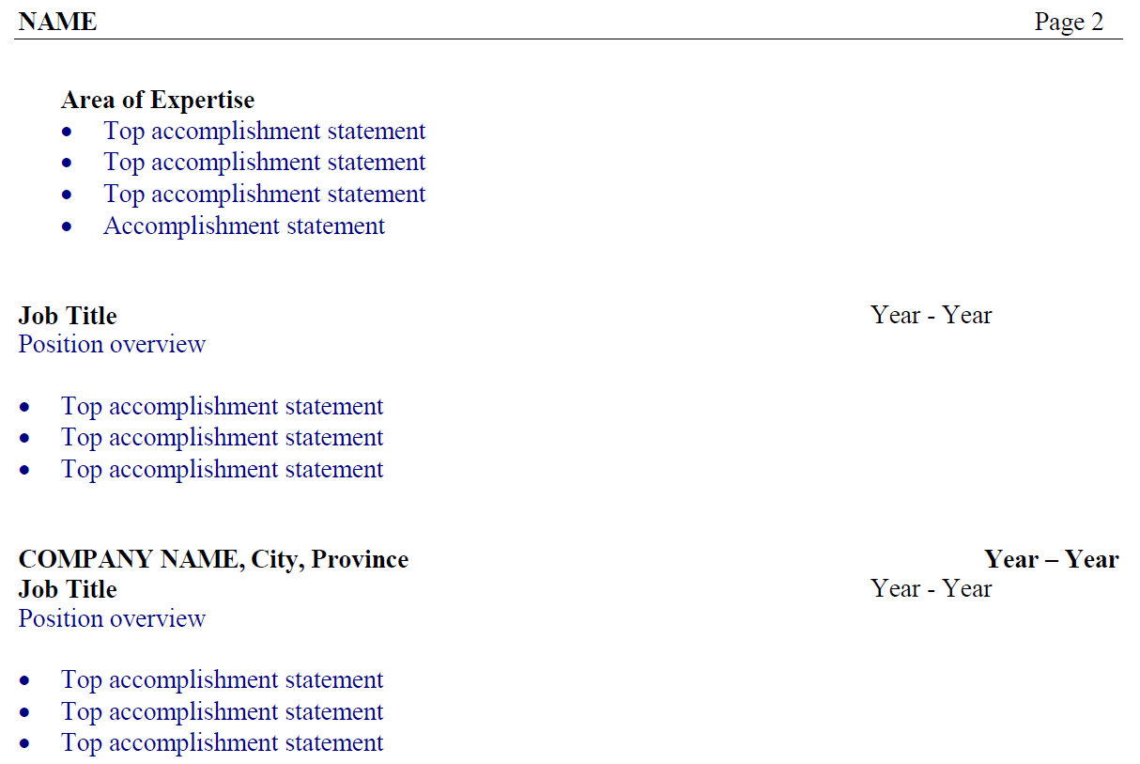
Professional experience continued

Slide 35
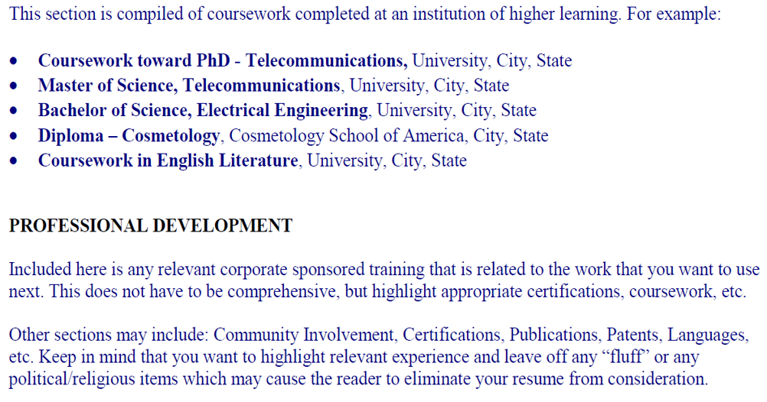
education

Slide 36
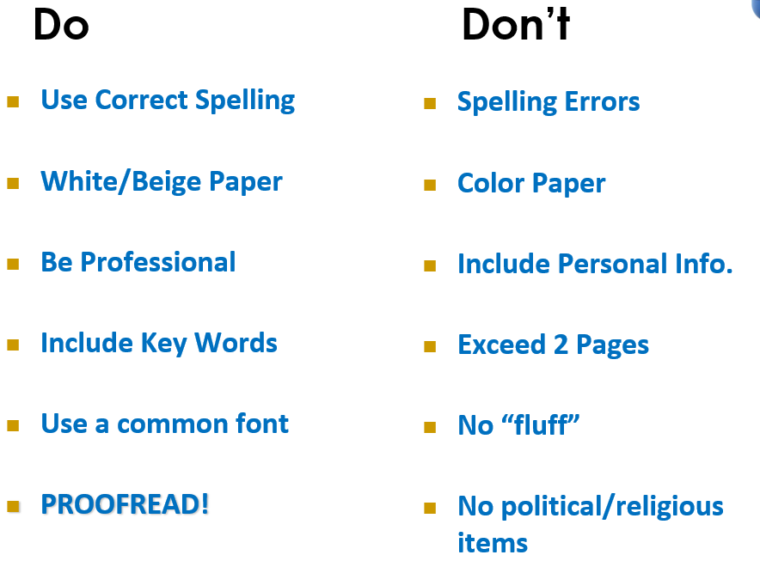
Do’s and don’ts

Slide 37

Before you submit your resume
STOP and ensure that contents on social networking sites is work appropriate

Slide 38
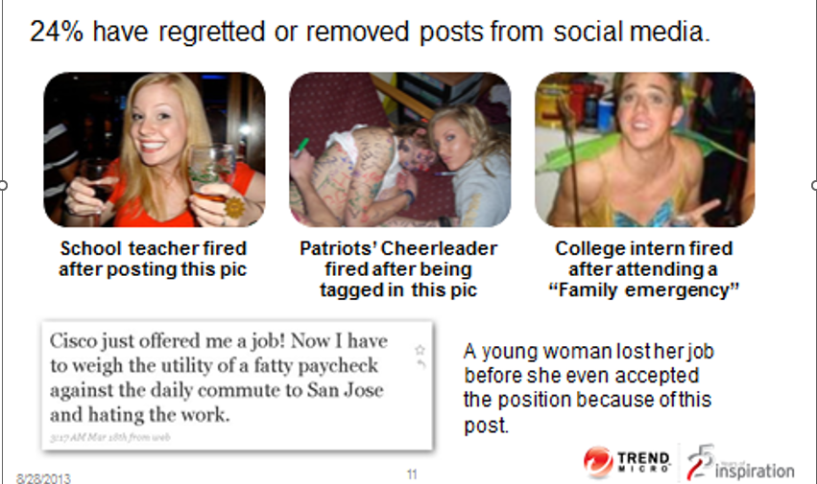
Consequences of not managing online personal privacy

Slide 39

Thank you
Connect With Us!
Facebook.com/MeriwestCreditUnion
Twitter.com/meriwest
Linkedin.com/company/meriwest
Instagram.com/meriwest
TikTok @meriwestcreditUnion

Slide 40
questions

